Slide 1
def callGoBestCab(){
drivers_data.h5
sensor_safety_data.h5
print(‘PAI CA2’)
# DAAA/FT/2B/01
# Tan Wen Tao Bryan (2214449)
# Ryan Yeo (2214452)
# Zachary Leong Yao Jie (2201861)
# Ethan Pang Kin Fong (2214241)
}
GoBest Cab

Slide 2
Content Page
Dataset
Advanced Data Preprocessing
Outlier Analysis
Imbalanced Classes
Machine Learning
Machine Optimization
Export Final Model
Monitoring with MLFlow
Tkinter Application
Conclusion

Slide 3
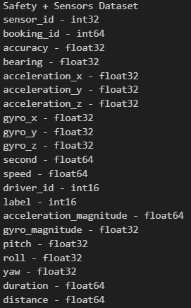
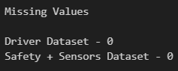
01 {
[Datasets]
Read two hdf files in a chunksize of 10,000
cab_driver_df is made up of 500 rows and 10 columns
sensor_safety_df is made up of 7,126,686 rows and 21 columns
No missing values in the data
The team will not be using cab_driver_df for a few reasons:
Information is static, meaning that more booking trips of the same diver will result in heavy bias that affect model predictions
Information from cab_driver_df is incompatible with real time data needed for Go_Best_Cab machine learning application
}

Slide 4
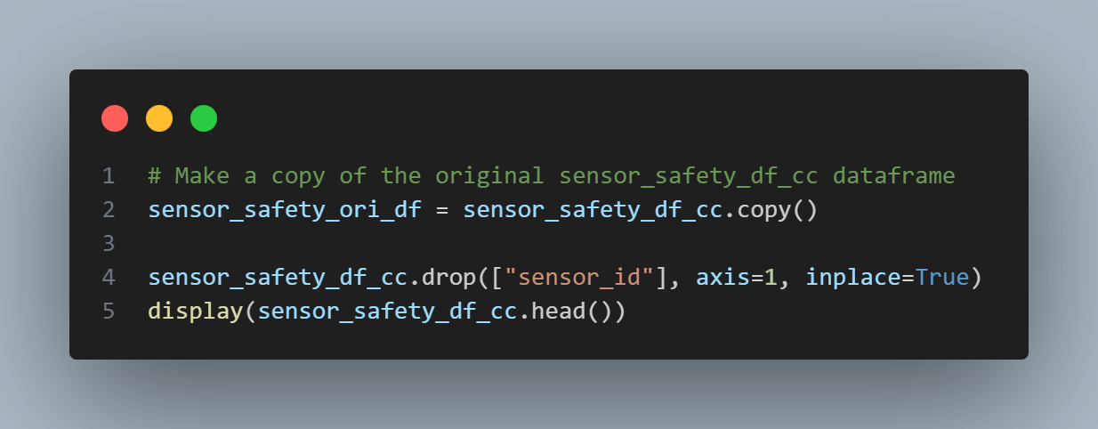
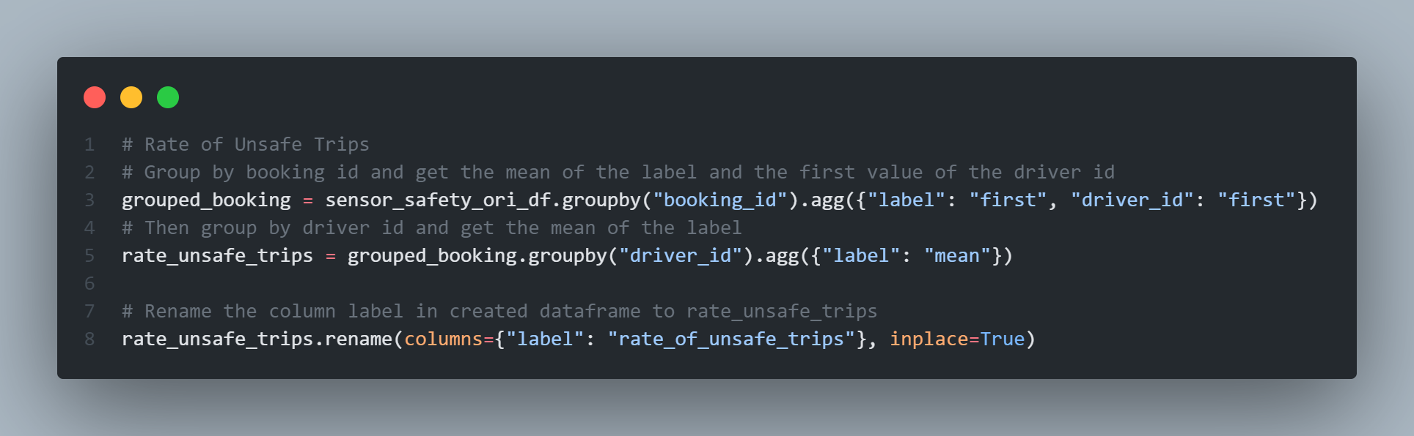
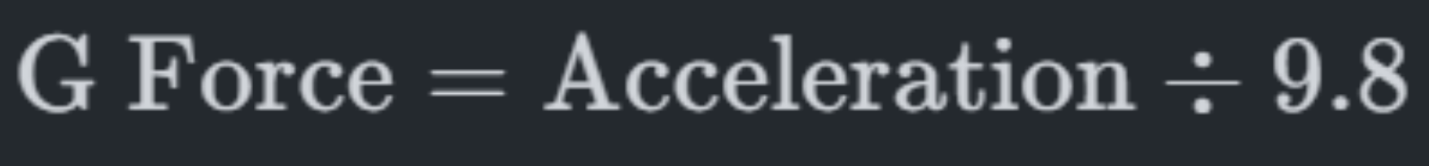
02 {
[Advanced Data Preprocessing]
Drop Unwanted columns:
Drop sensor_id since it is unique
Feature Engineering:
Pitch, Roll, Yaw, Distance
Rate of unsafe trips
G-Force
}

Slide 5
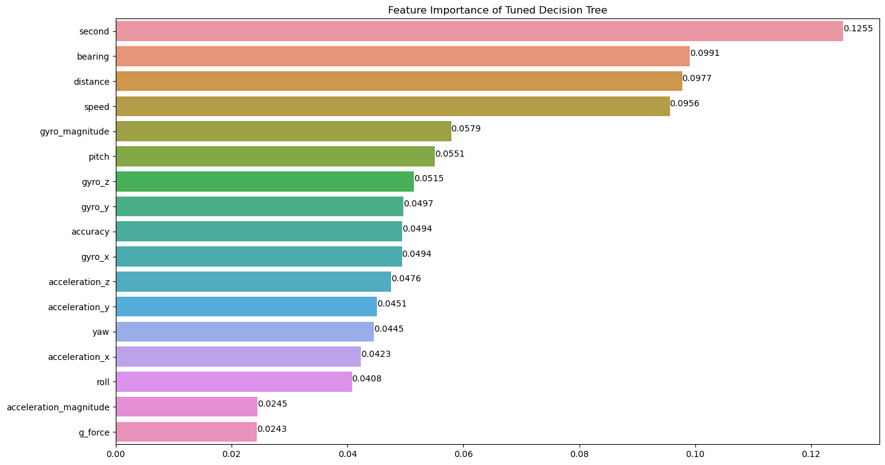
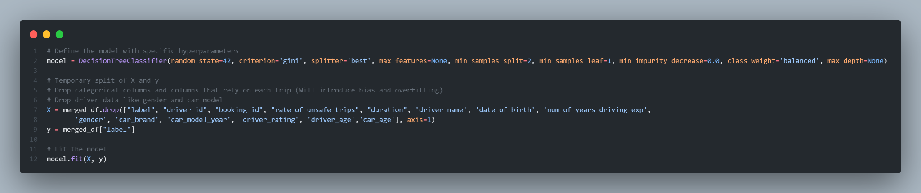
02 {
[Advanced Data Preprocessing]
Feature Selection:
Use Feature Importance to decide which features to keep (coeff > 0.04)
Use of Decision Tree to show Feature Importance
}

Slide 6
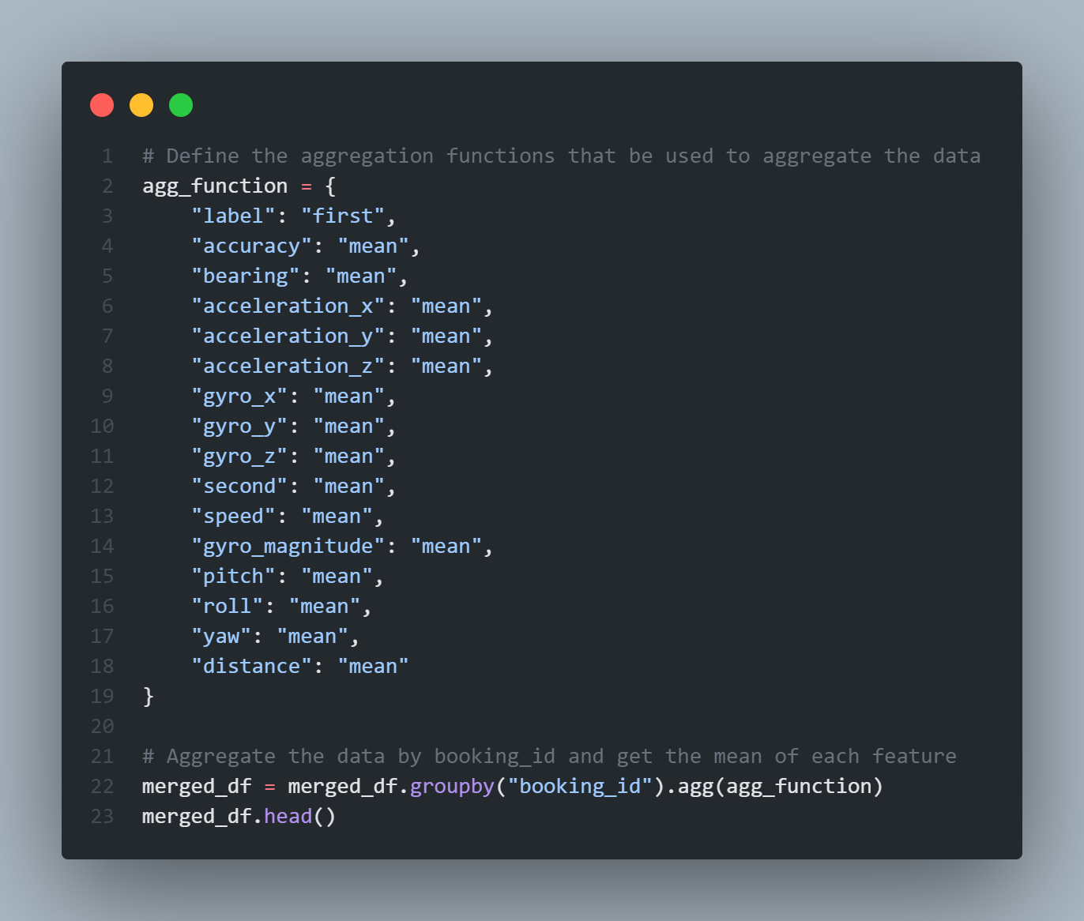
02 {
[Advanced Data Preprocessing]
Aggregate Function:
Group the dataframe by bookingID and aggregate the data based on the mean value
Significantly reduced the number of rows to ~20,000 (19,972 Booking ID)
}

Slide 7
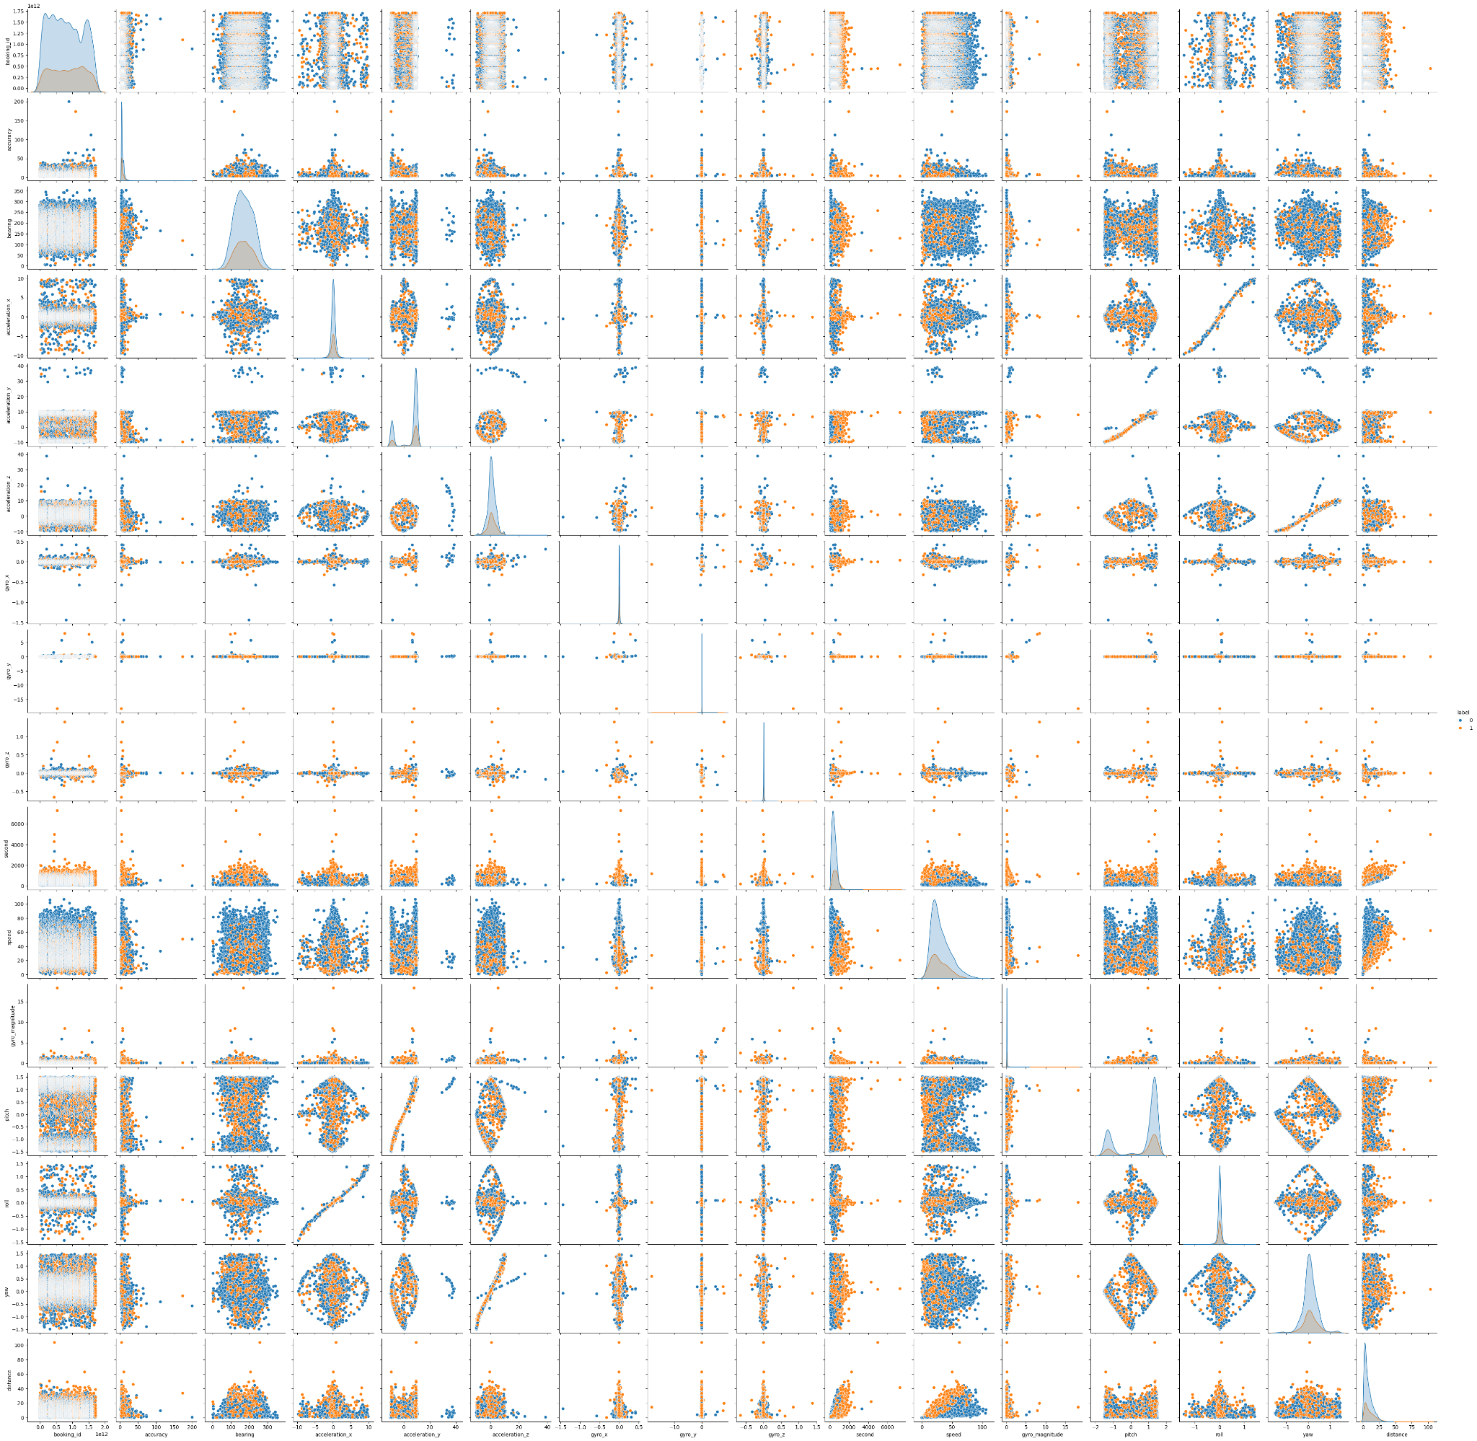
03 {
[Outlier Analysis]
Observations:
Start by analysing the pair plot
Elliptic shape can be spotted in some of the features
}

Slide 8
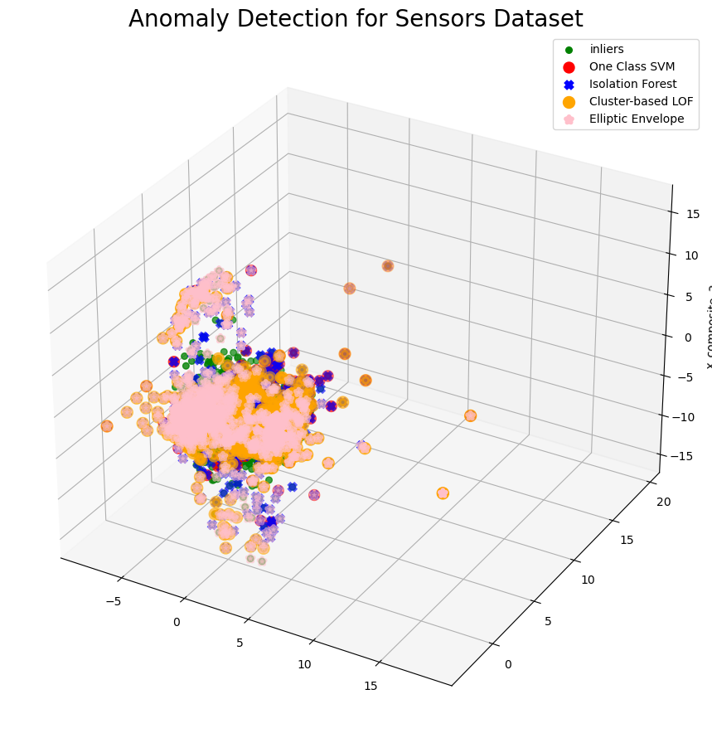
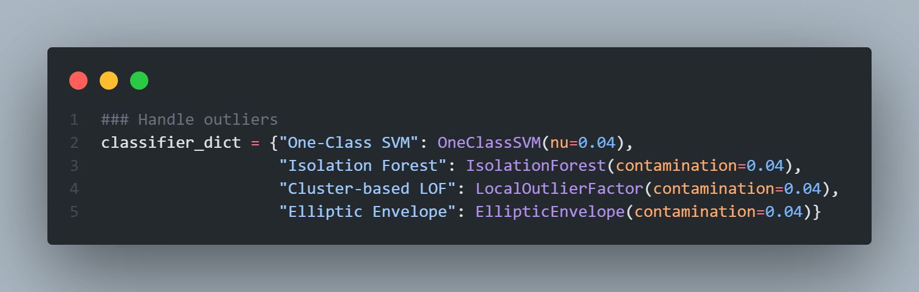
03 {
[Outlier Analysis]
Anomaly Detection Methods:
One-Class SVM
Isolation Forest
Cluster-Based LOF
Elliptic Envelope
Visualise anomalies using PCA to reduce dimensionality
}

Slide 9
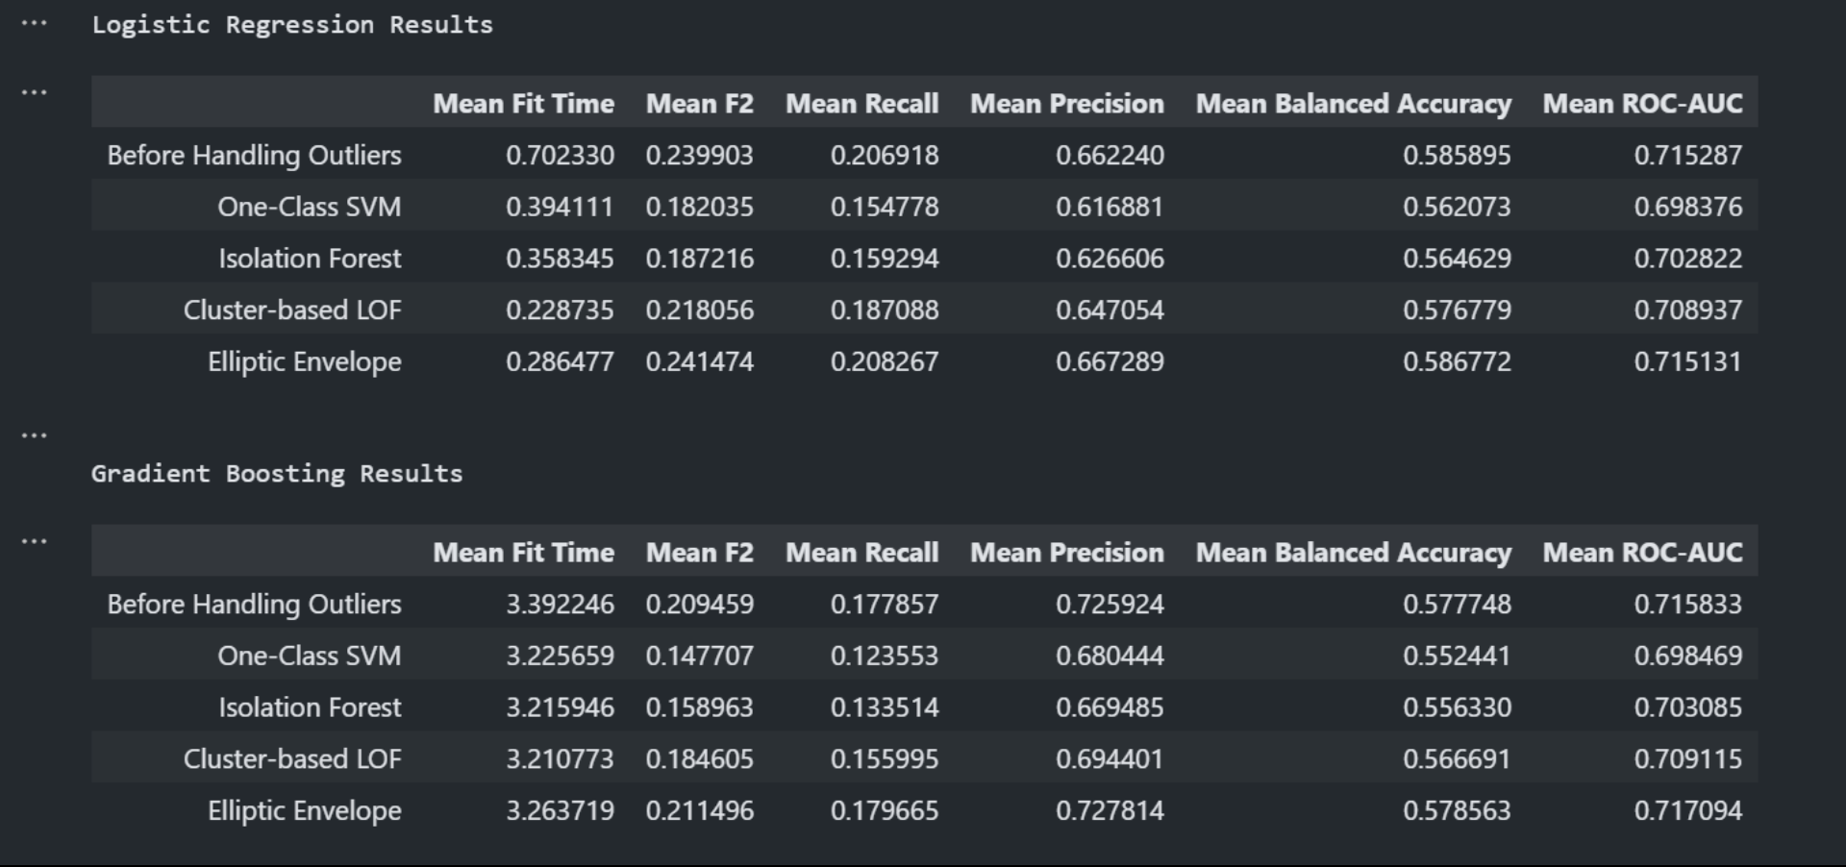
03 {
[Outlier Analysis]
Performance with different Outlier Detection Methods:
Elliptical Envelope is the best outlier detection model due to the improvement in F2, Recall, Accuracy and even mean fit time when compared to other Outlier Detection Methods
}

Slide 10
04 {
[Imbalanced Classes]
Ways to handle imbalance classes:
Data level Methods
Oversampling - Zero information loss, but increases likelihood of overfitting
Undersampling - Improves run time and storage, but will discard useful information
SMOTE - Mitigates problems of overfitting and information loss, but not very effective for high dimensional data
Algorithm-level methods
Class Weight Adjustment - Improves recall of minority class, but in the meantime brings down precision significantly
XGBoost - Simple to implement and generalize well, but sensitive to noisy data and outliers
Hybrid methods
Combination of data level methods and algorithm-level methods
}

Slide 11
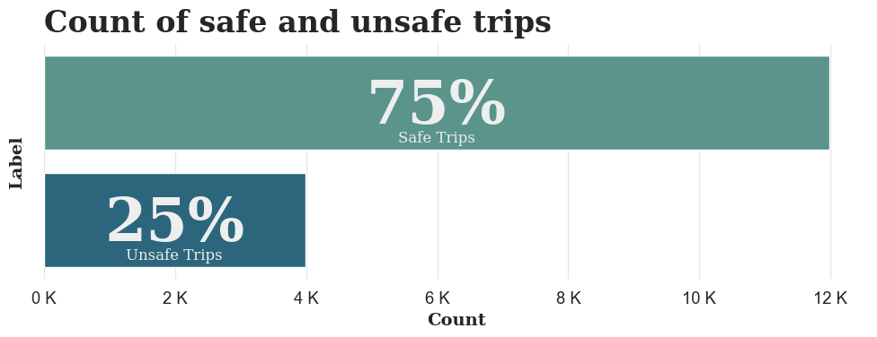
04 {
[Imbalanced Classes]
Observations:
There are more safe trips than unsafe trips
With a 70/30 split in labels the data is moderately imbalanced
}

Slide 12
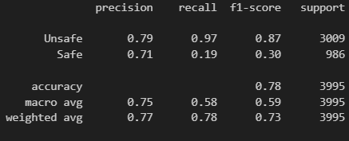
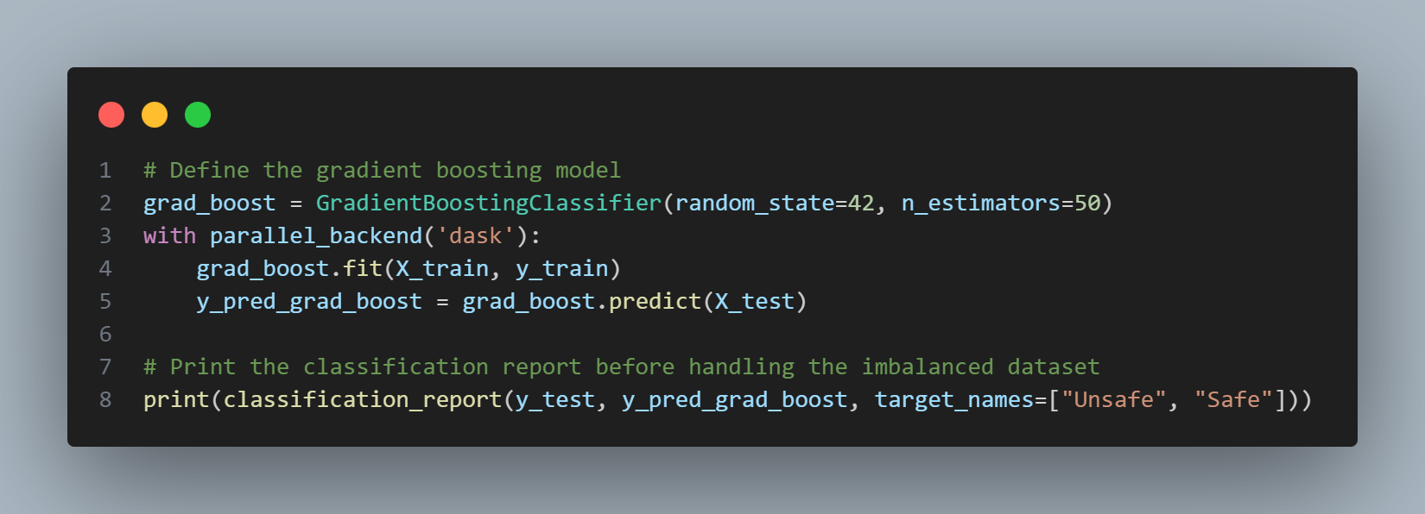
04 {
[Imbalanced Classes]
Before
Observations:
Imbalance number of classes with way more counts for unsafe labels than safe labels
Significantly lower recall and f1-score for safe labels compared to unsafe labels
}

Slide 13
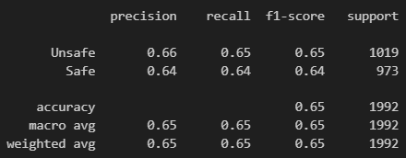
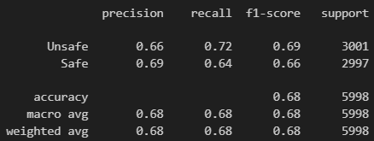
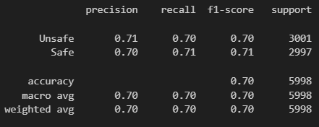
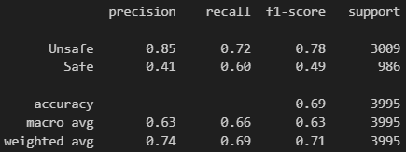
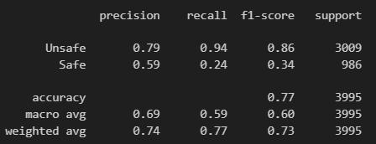
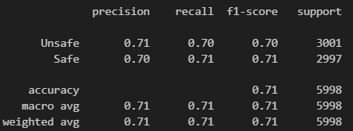
[Imbalanced Classes]
Undersampling
Oversampling
SMOTE
SMOTE & Class Weight Adjustment
Class Weight Adjustment
Boosting Models
Best Method

Slide 14
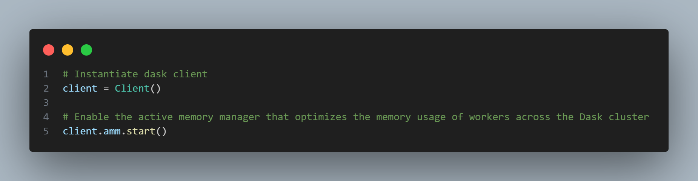
05 {
[Machine Learning]
Dask:
Dask is a library with features of parallelism and scalability that is useful for modelling tasks that involves huge dataset
Allows us to scale computations down to make it possible to work with large datasets on a single machine and provides parallel computing capabilities which greatly reduces the time taken to train each model
}

Slide 15
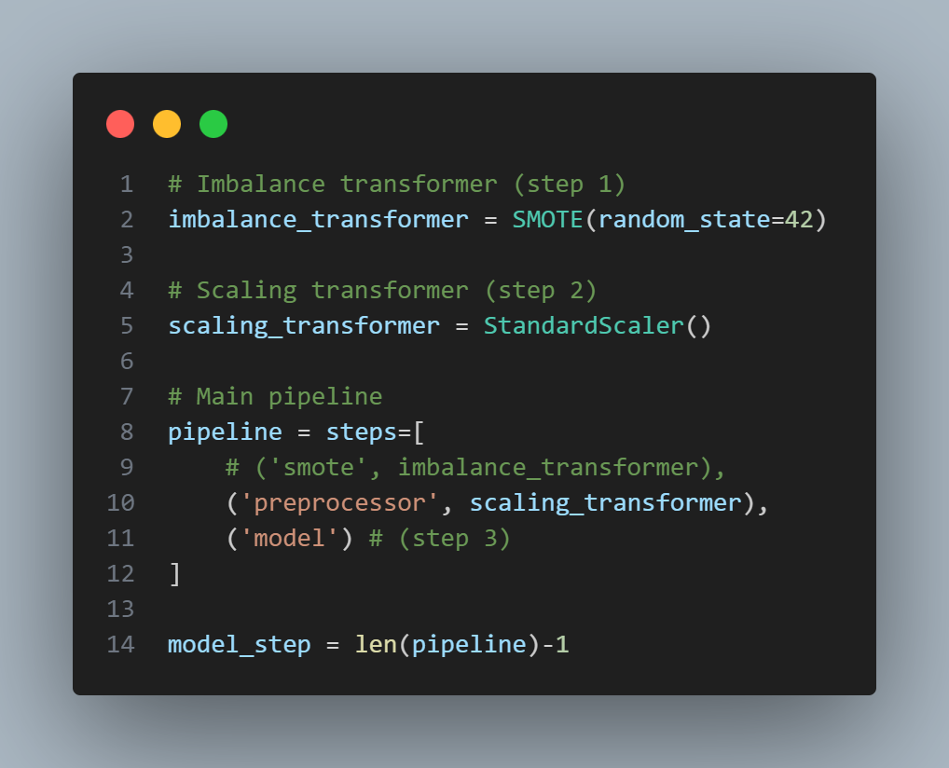
05 {
[Machine Learning]
Pipelines:
Pipelines allow us to streamline the machine learning process by compiling the preparation and transformation steps
Models used:
Random Forest
Logistics Regression
Naive Bayes
Decision Tree
Gradient Boosting
XGBoost
LightGBM
}

Slide 16
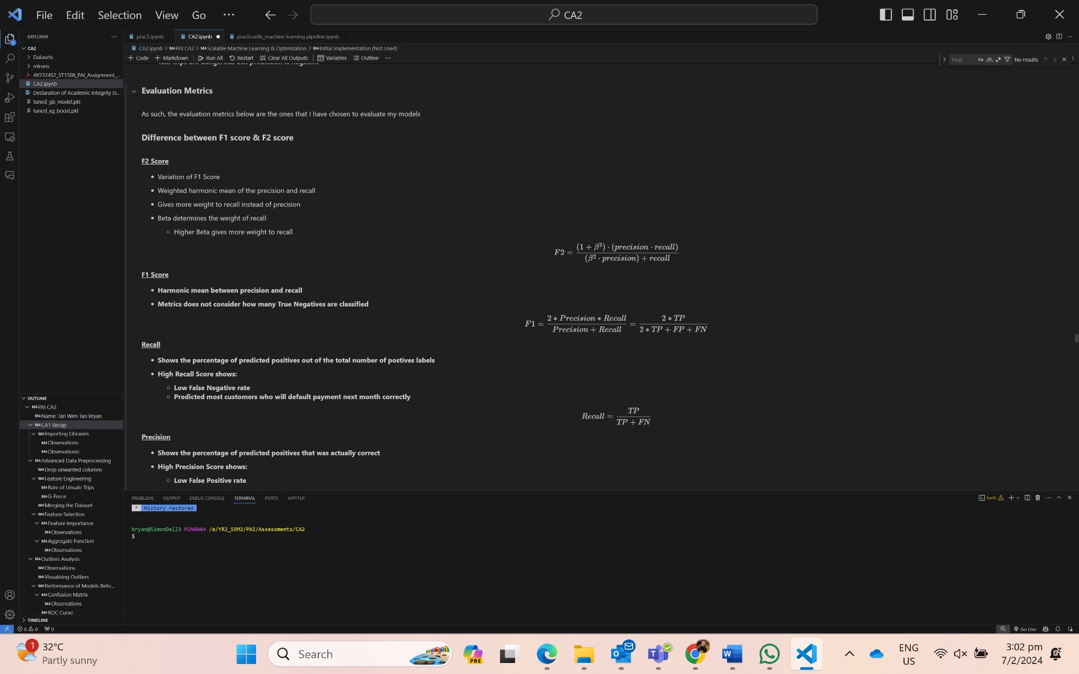
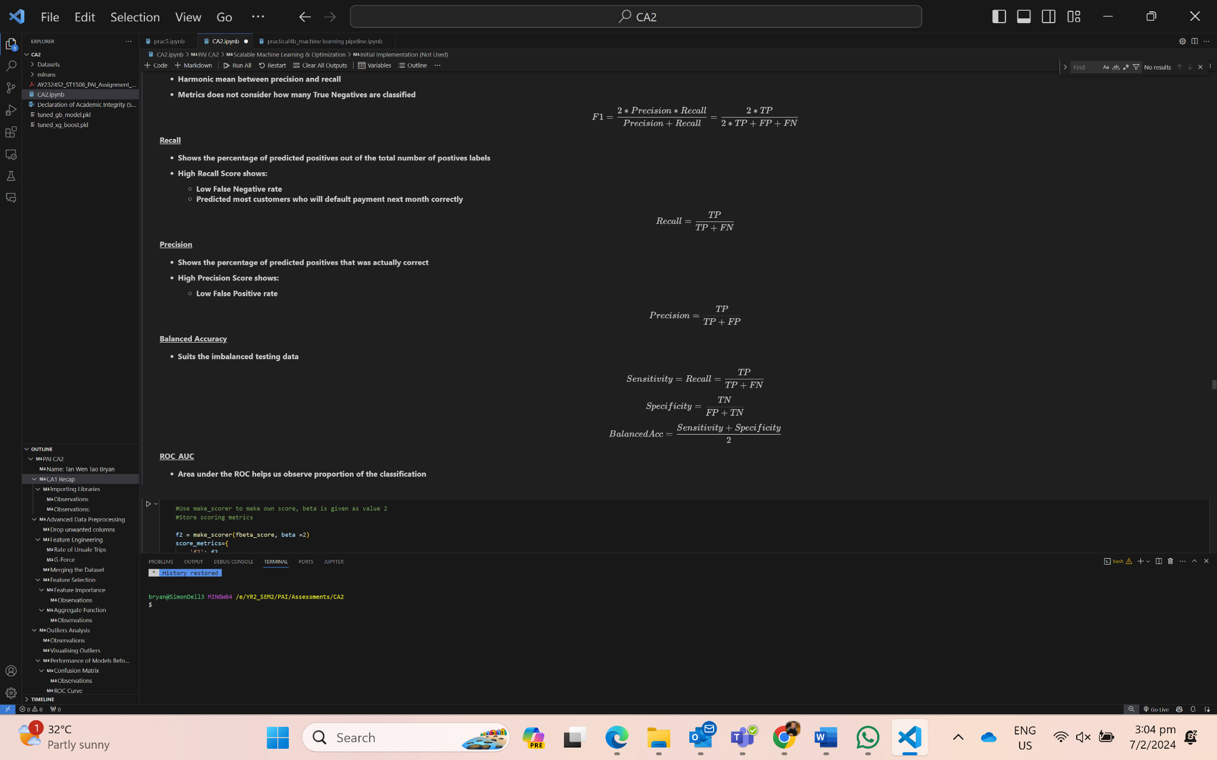
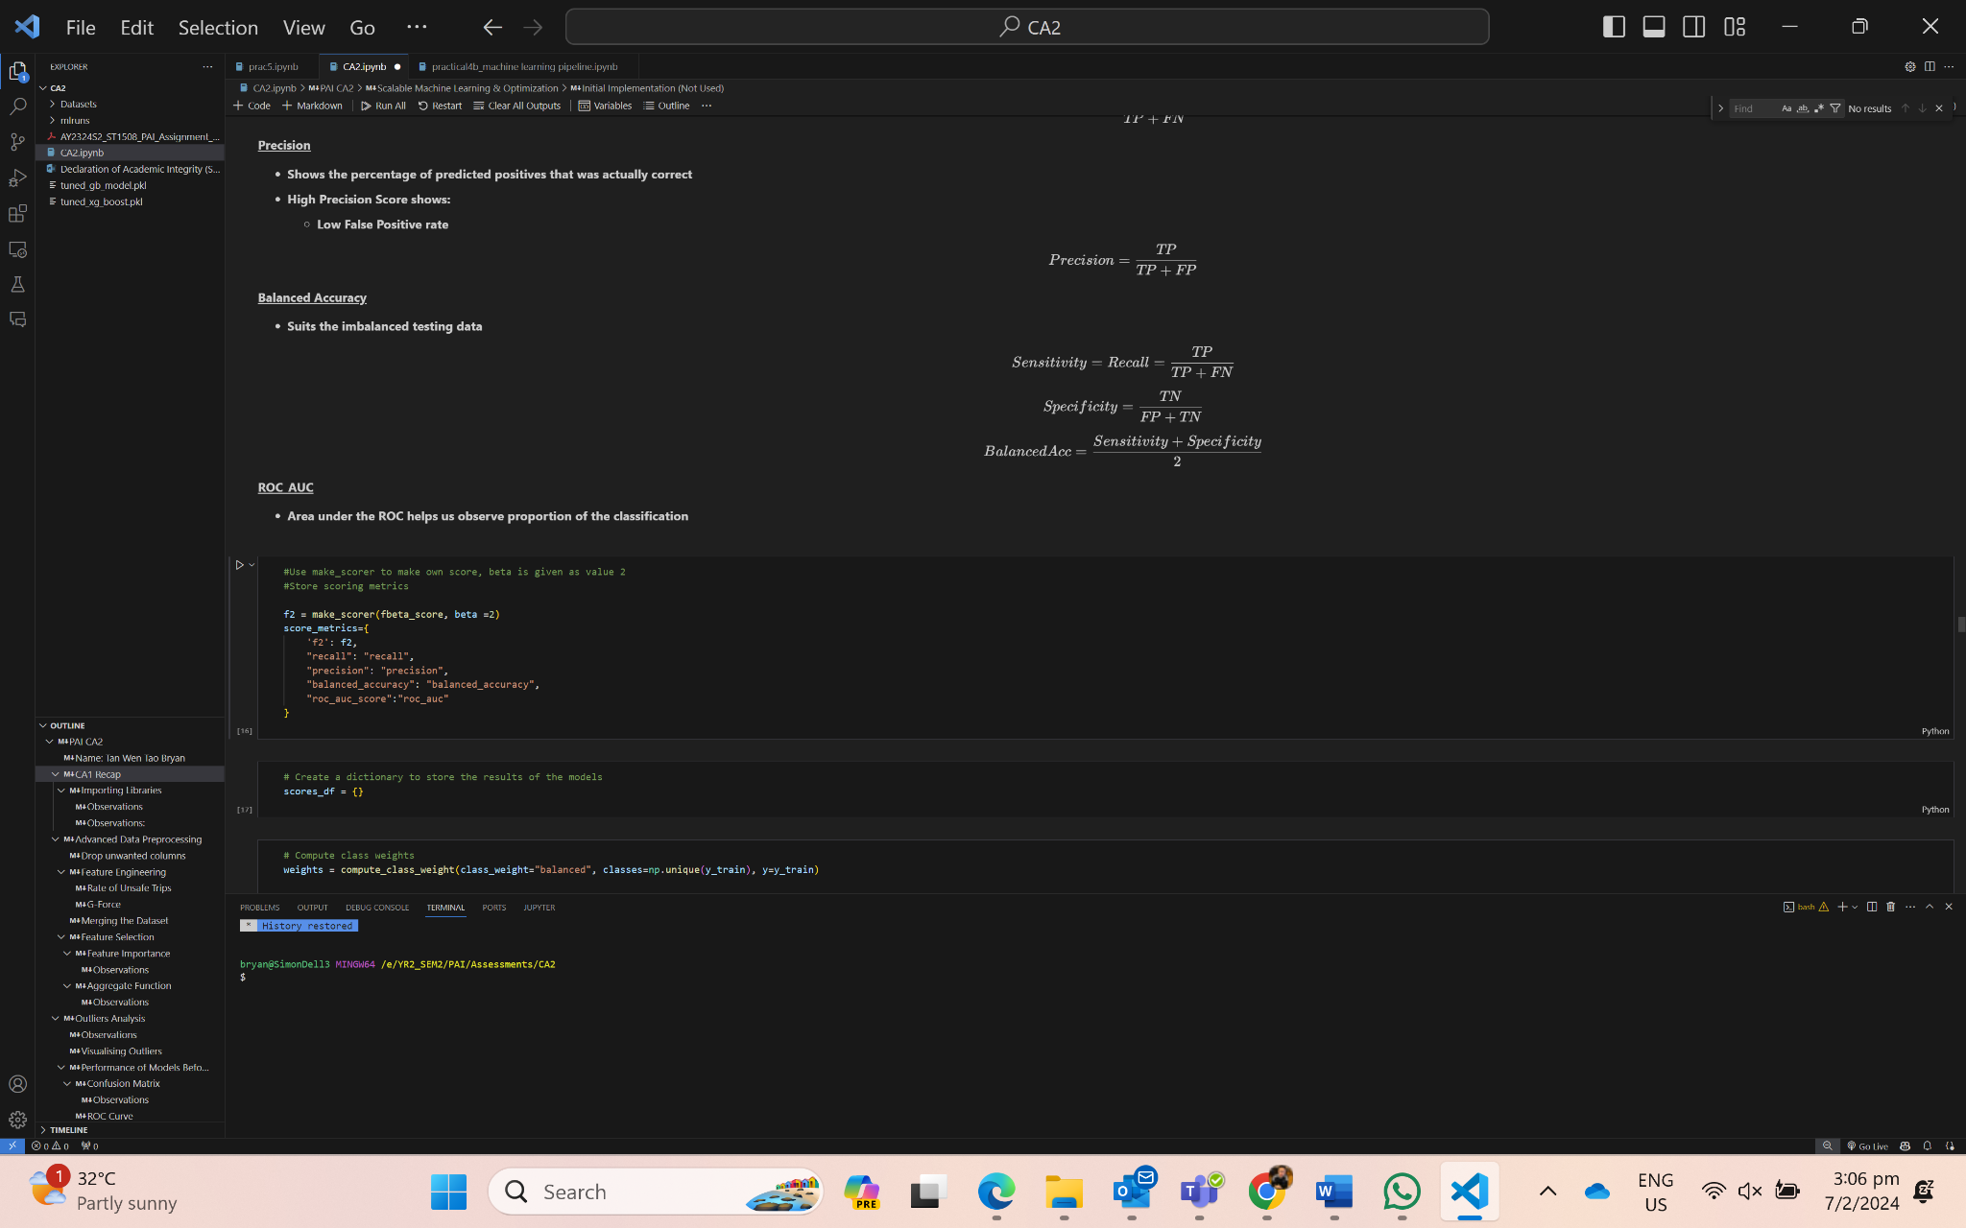
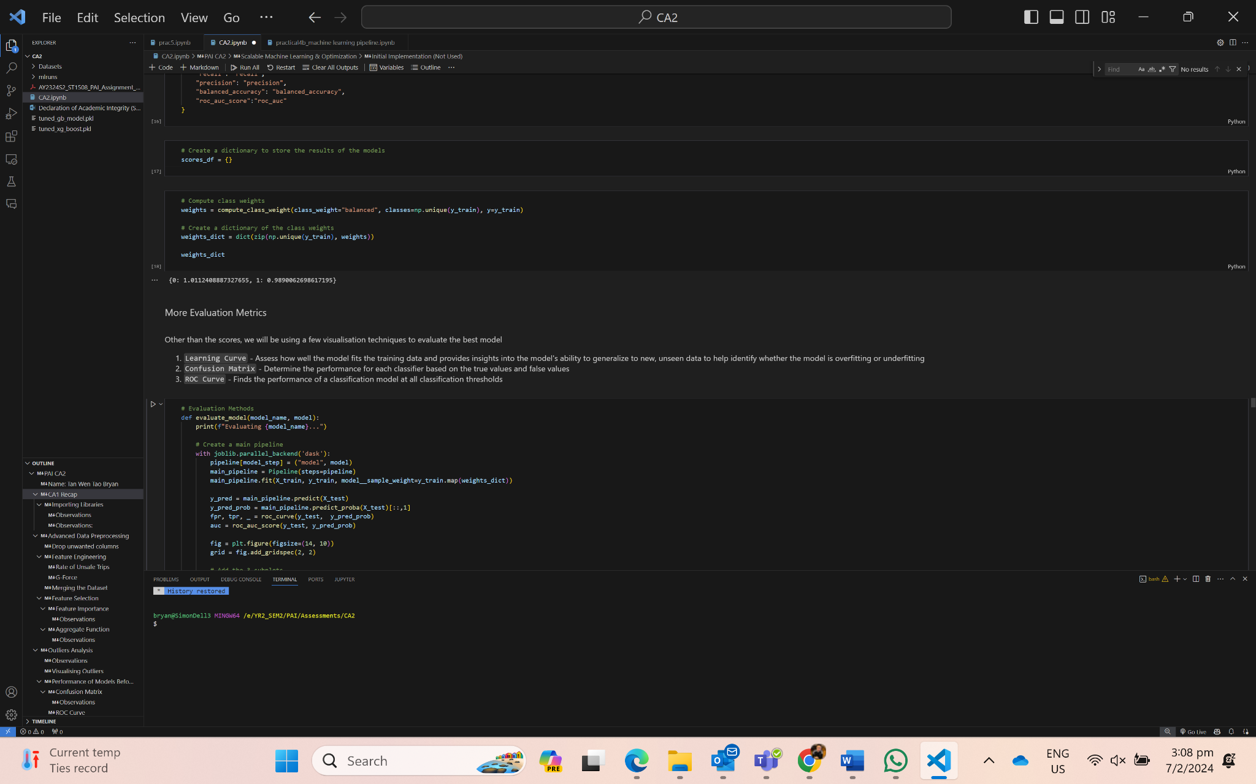
05 {
[Machine Learning]
Model Evaluation:
F2 score
Recall
Precision
Balanced Accuracy
ROC AUC
Learning Curve
Confusion Matrix
ROC curve
}

Slide 17
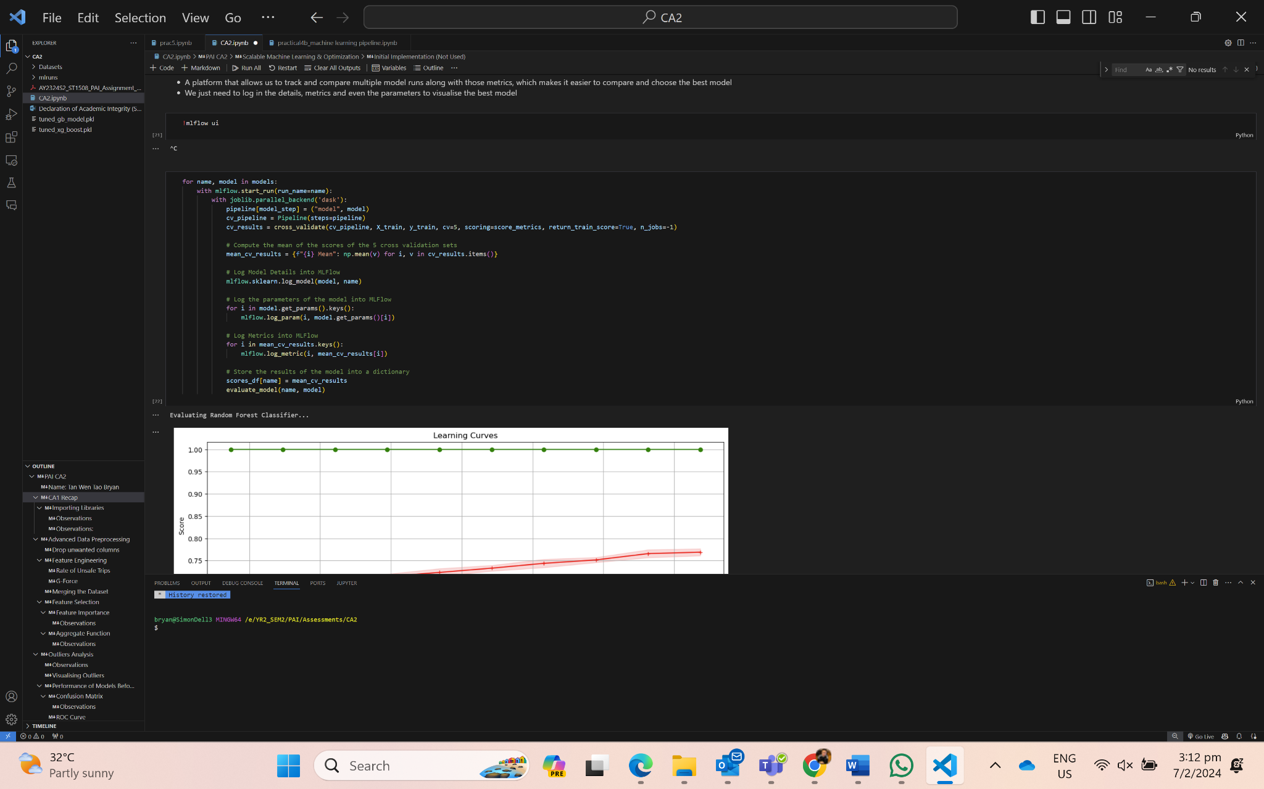
05 {
[Machine Learning]
MLFlow:
As the team is training the models, we should log in the model, the params and the metric into MLFlow to help with tracking and monitoring to evaluate the best model.
}

Slide 18
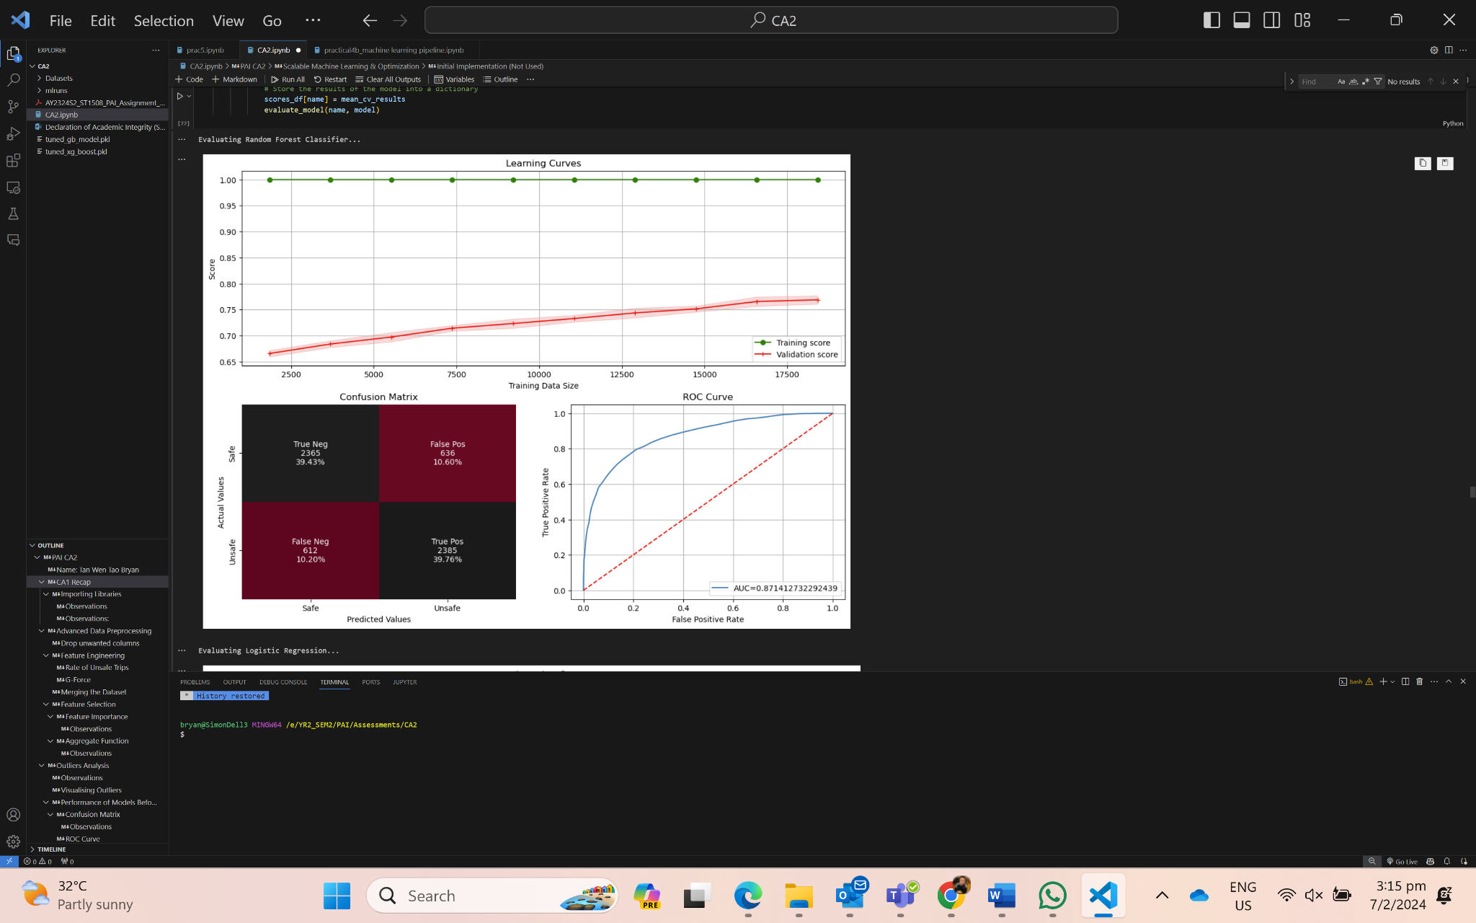
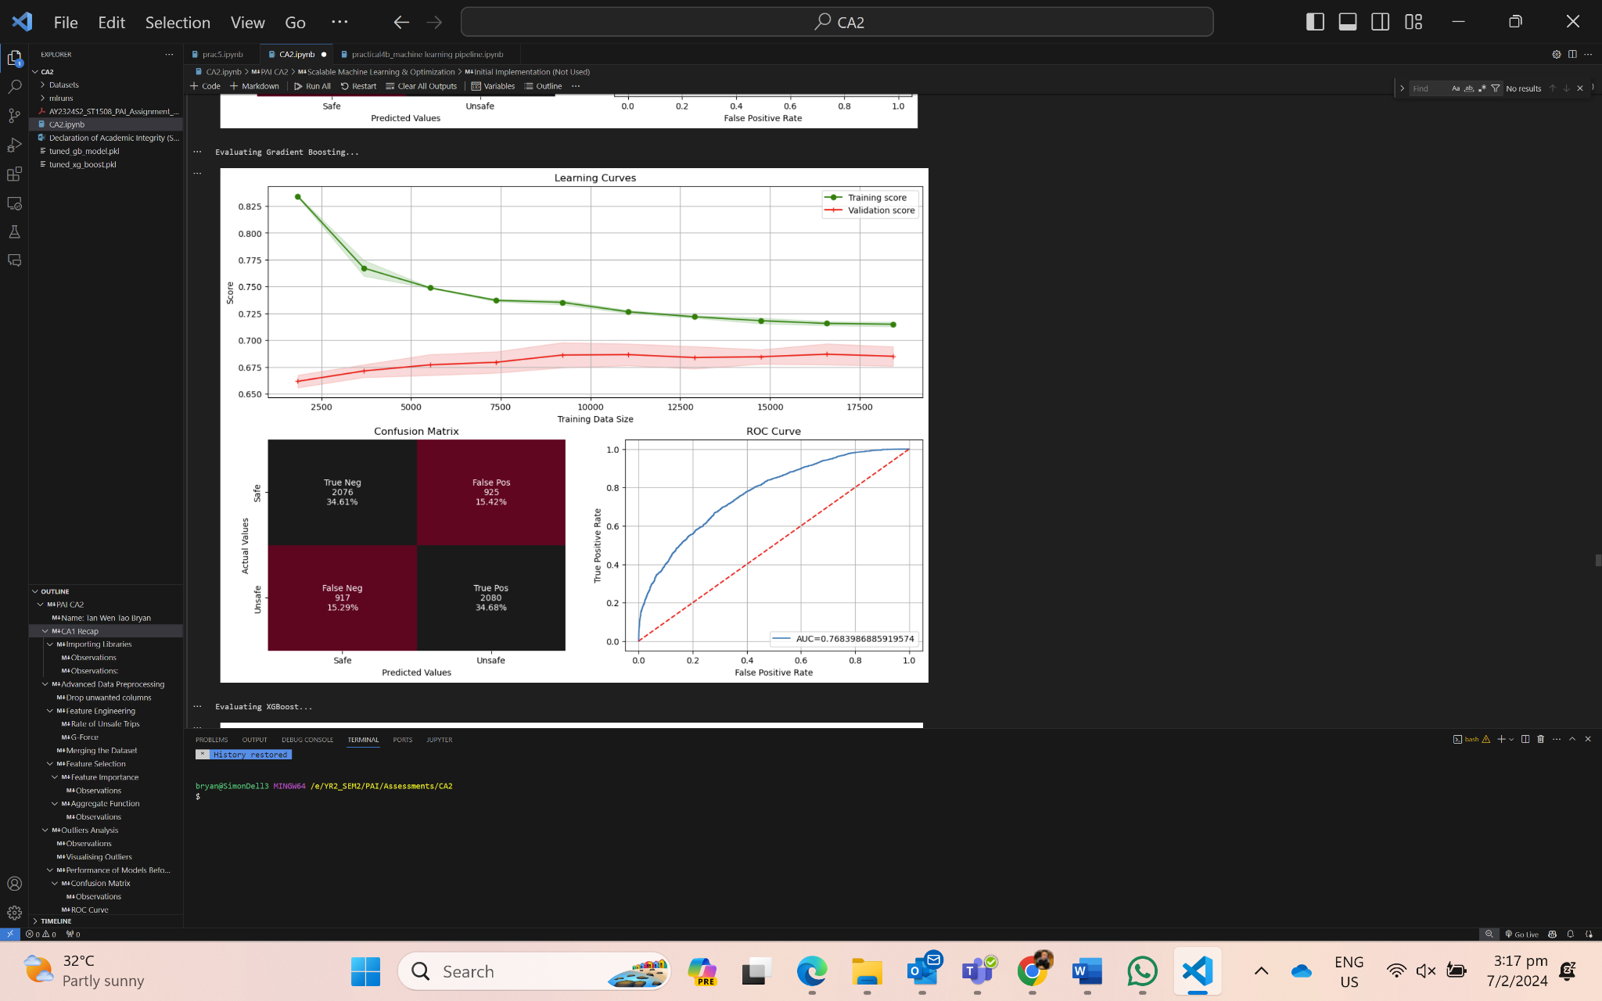
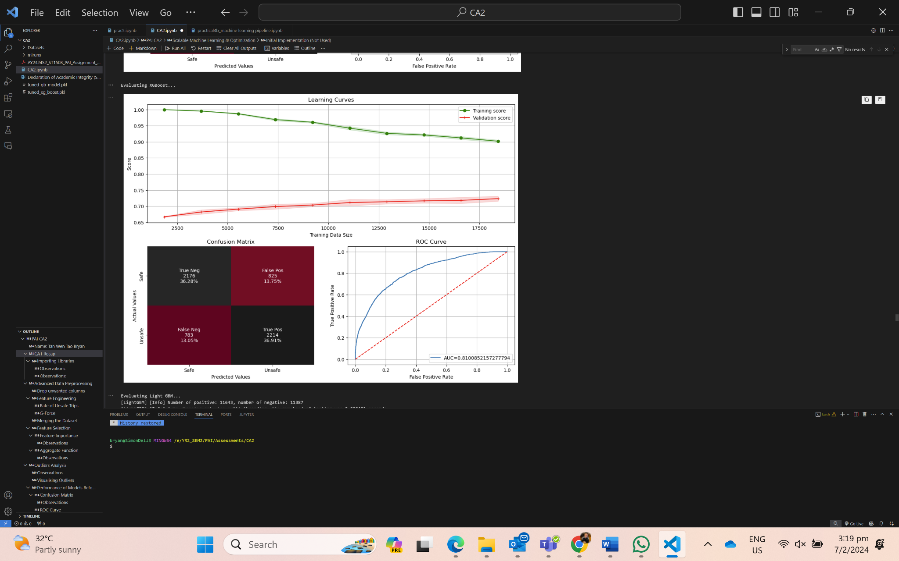
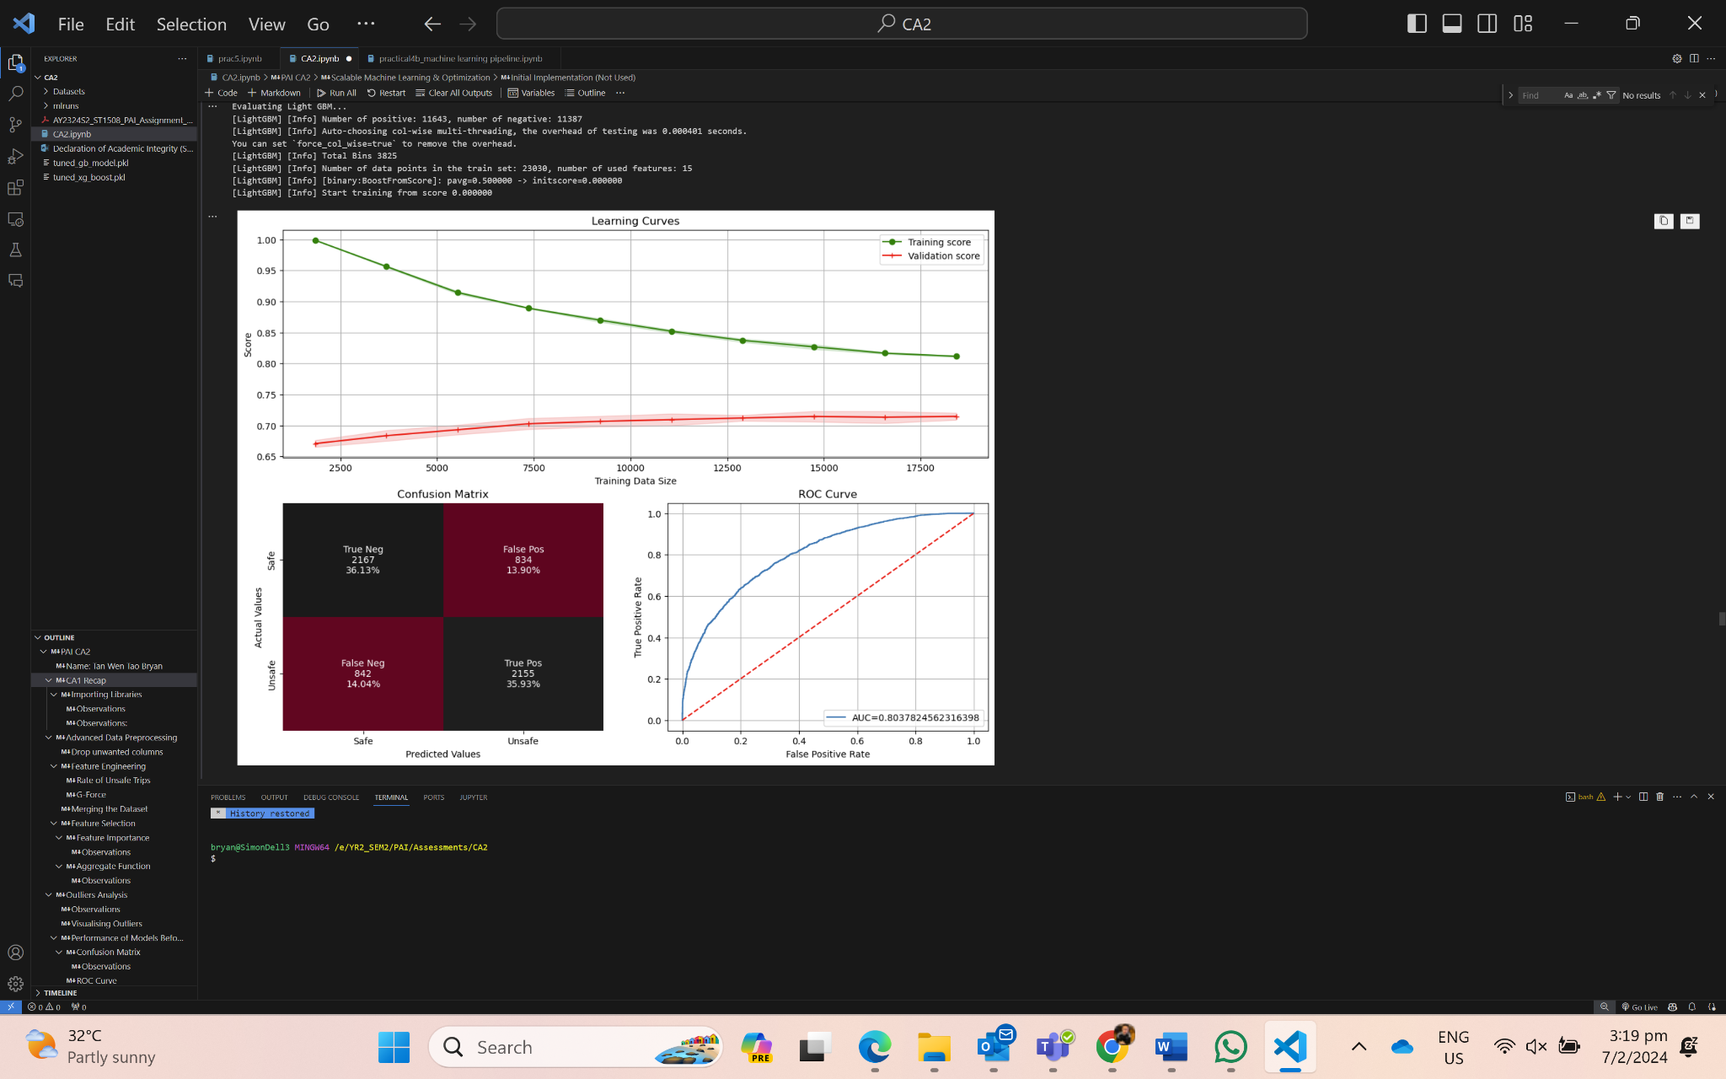
05 {
[Machine Learning]
Random Forest
Gradient Boosting
XGBoost
LightGBM
}
Model Training Observations:
The validation score increases as the data size increased, showing that the models are learning.
Training score for Random Forest is overfitted but the validation score shows that it is learning from the data.
The confusion matrix shows that Random Forest has the most number of True Positives and Negatives compared to the False Positives and Negatives, followed by XGBoost
AUC-ROC shows that Random Forest is the best model, followed by XGBoost and LightGBM.

Slide 19
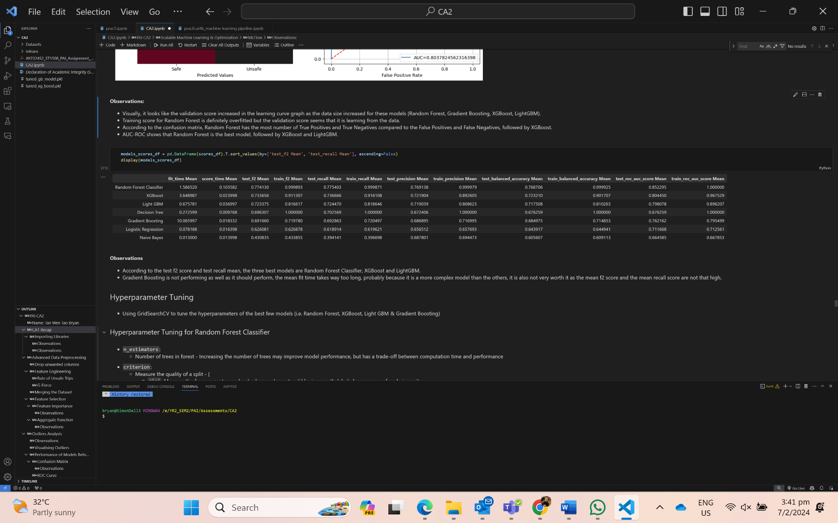
05 {
[Machine Learning]
Metrics Observations:
According to the test f2 score and test recall mean, the three best models are Random Forest Classifier, XGBoost and LightGBM.
Gradient Boosting is not performing as well as it should perform but we shall try to improve it too and see if the scores improved.
}

Slide 20
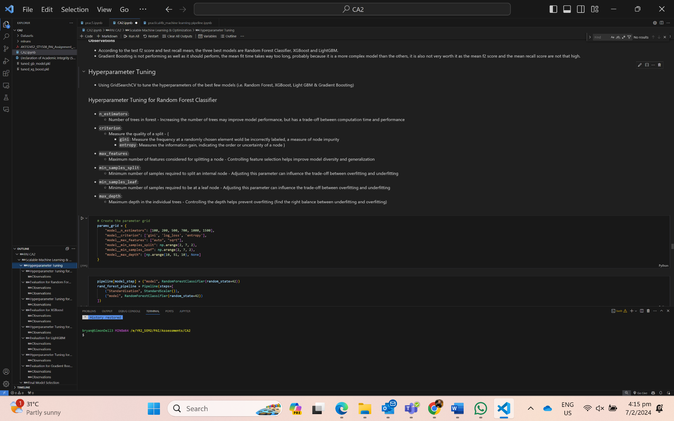
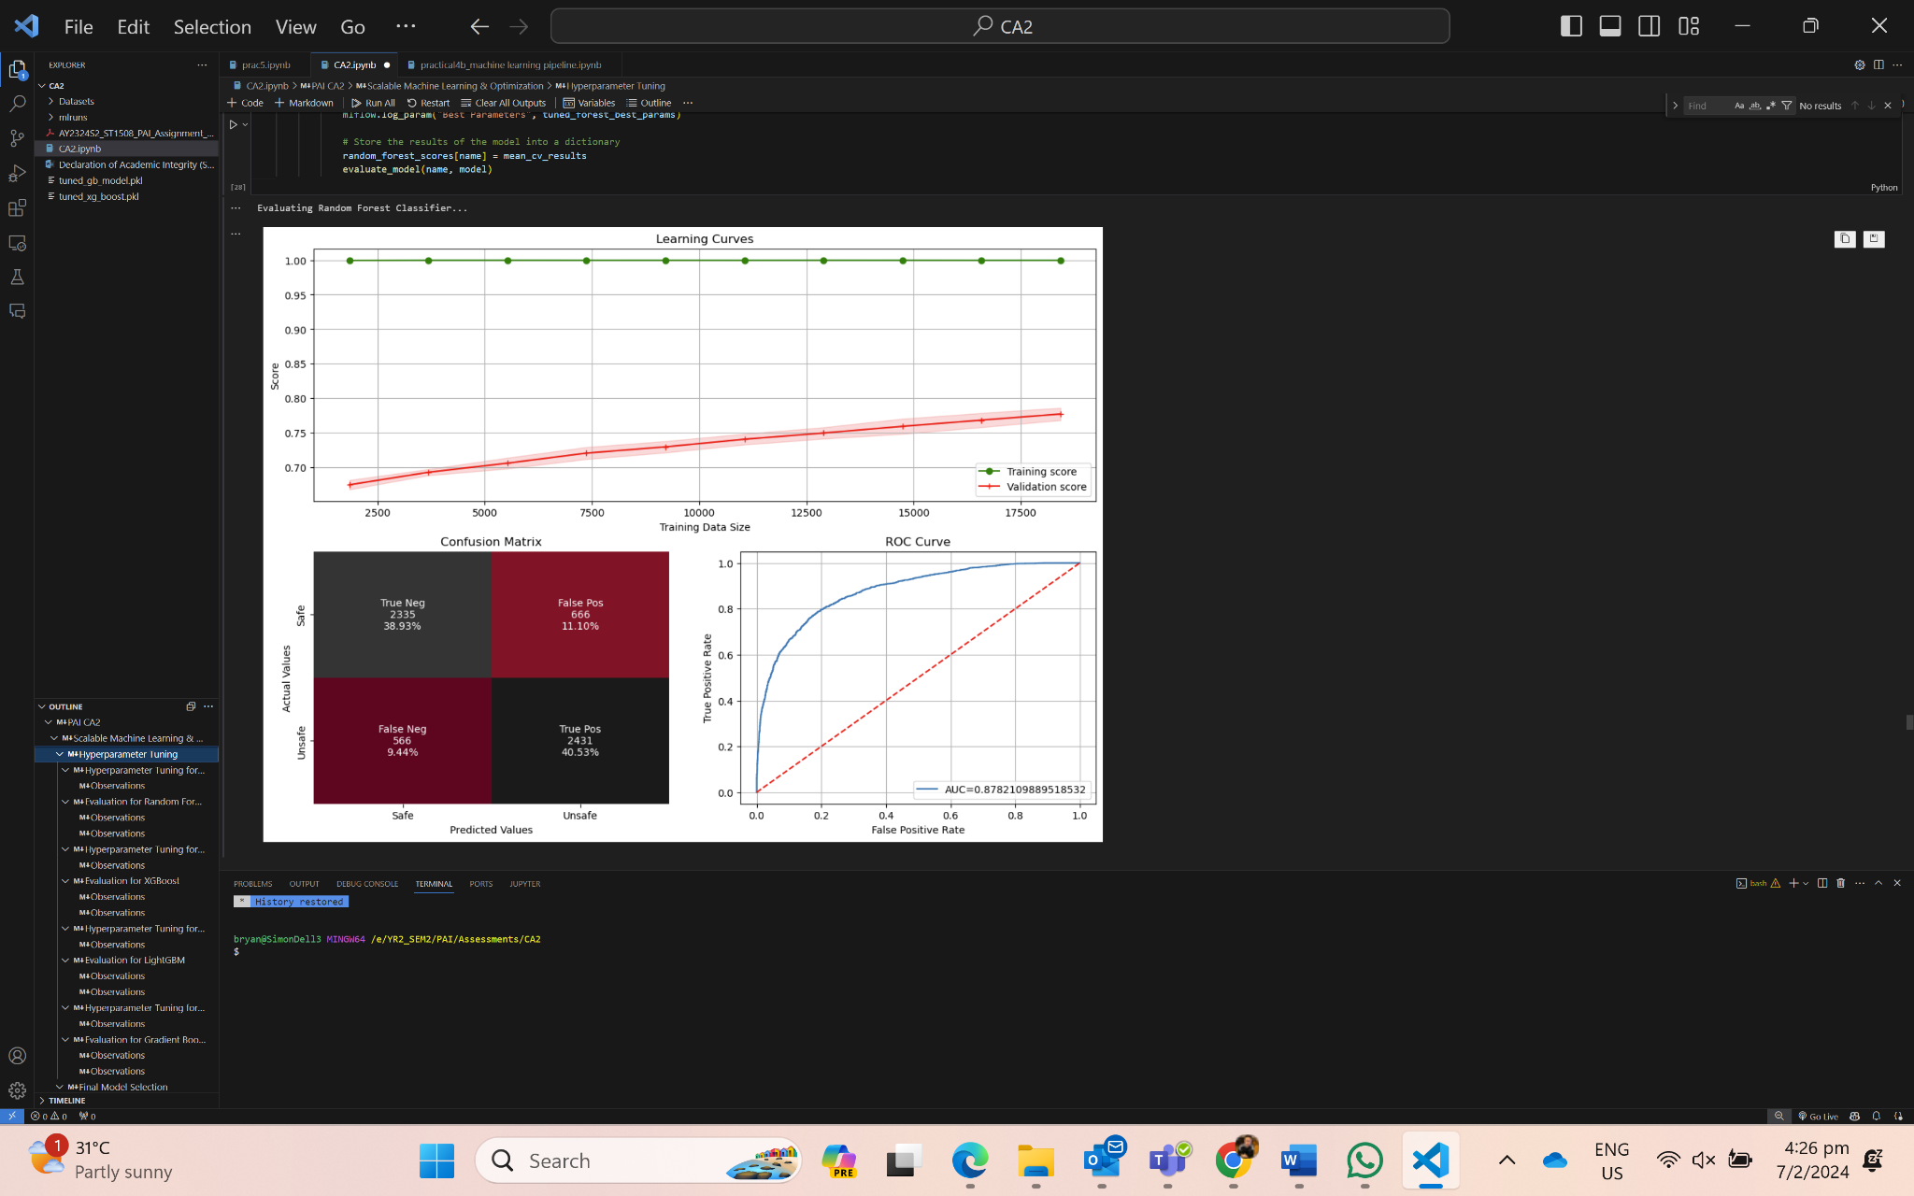
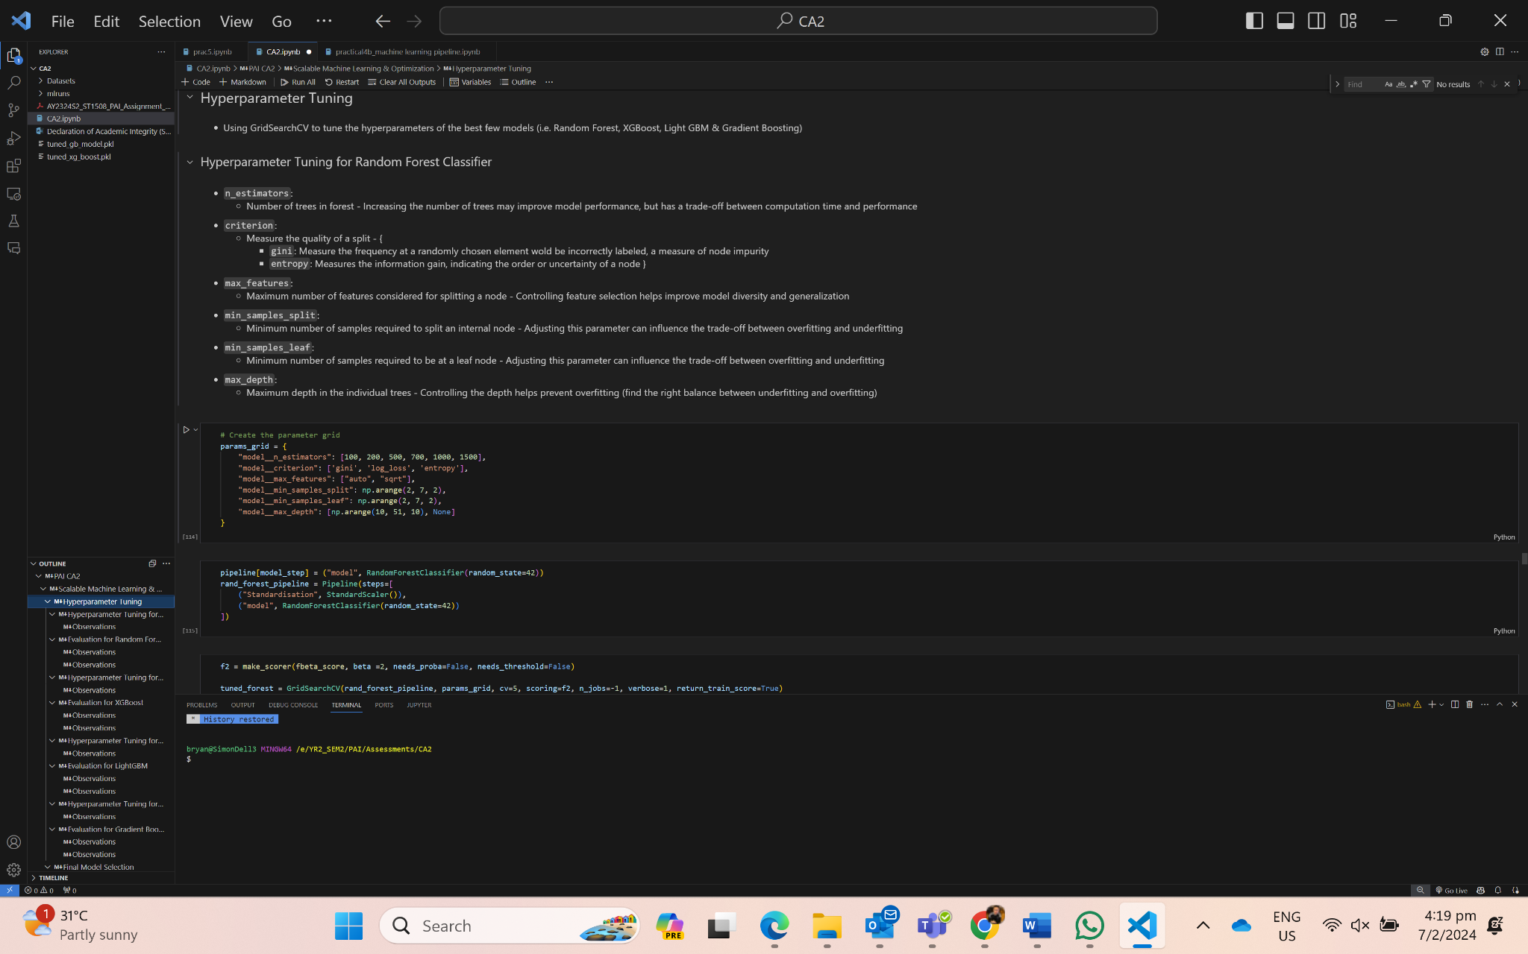
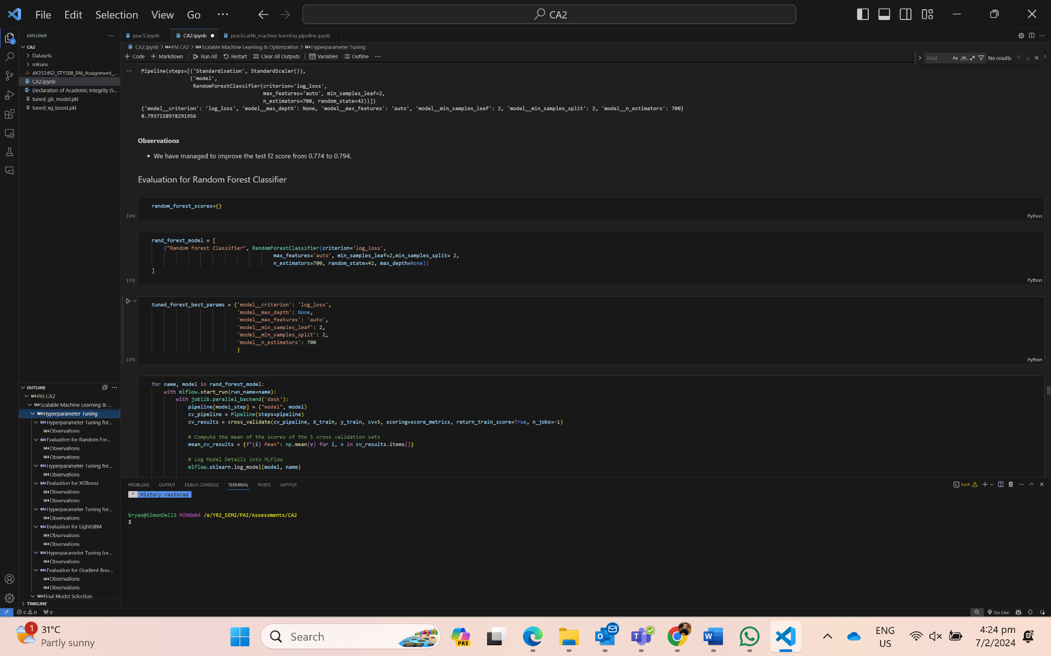
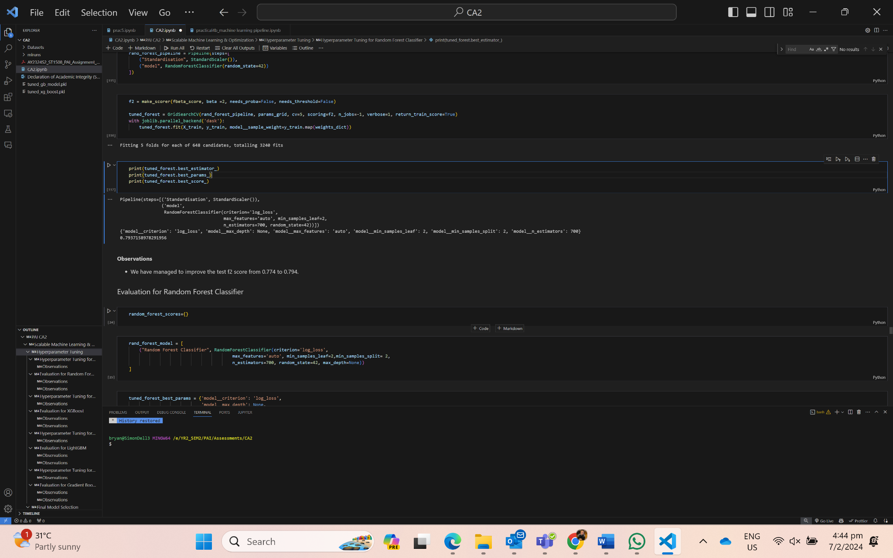
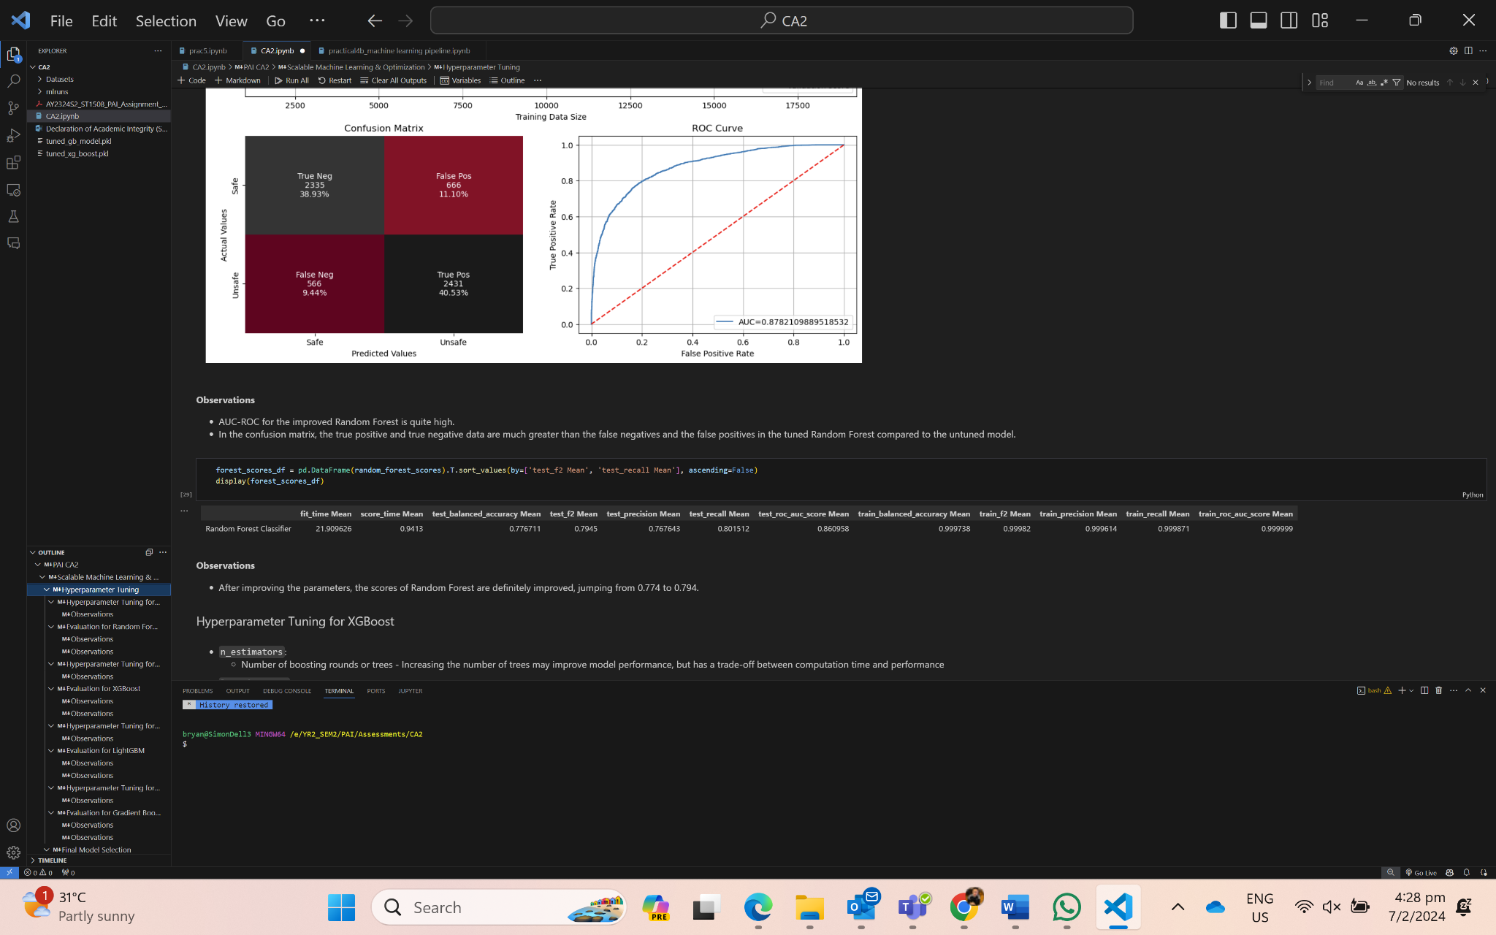
06 {
[Model Optimization (Random Forest)]
Param Grid
Optimal Parameters for best f2 score
}

Slide 21
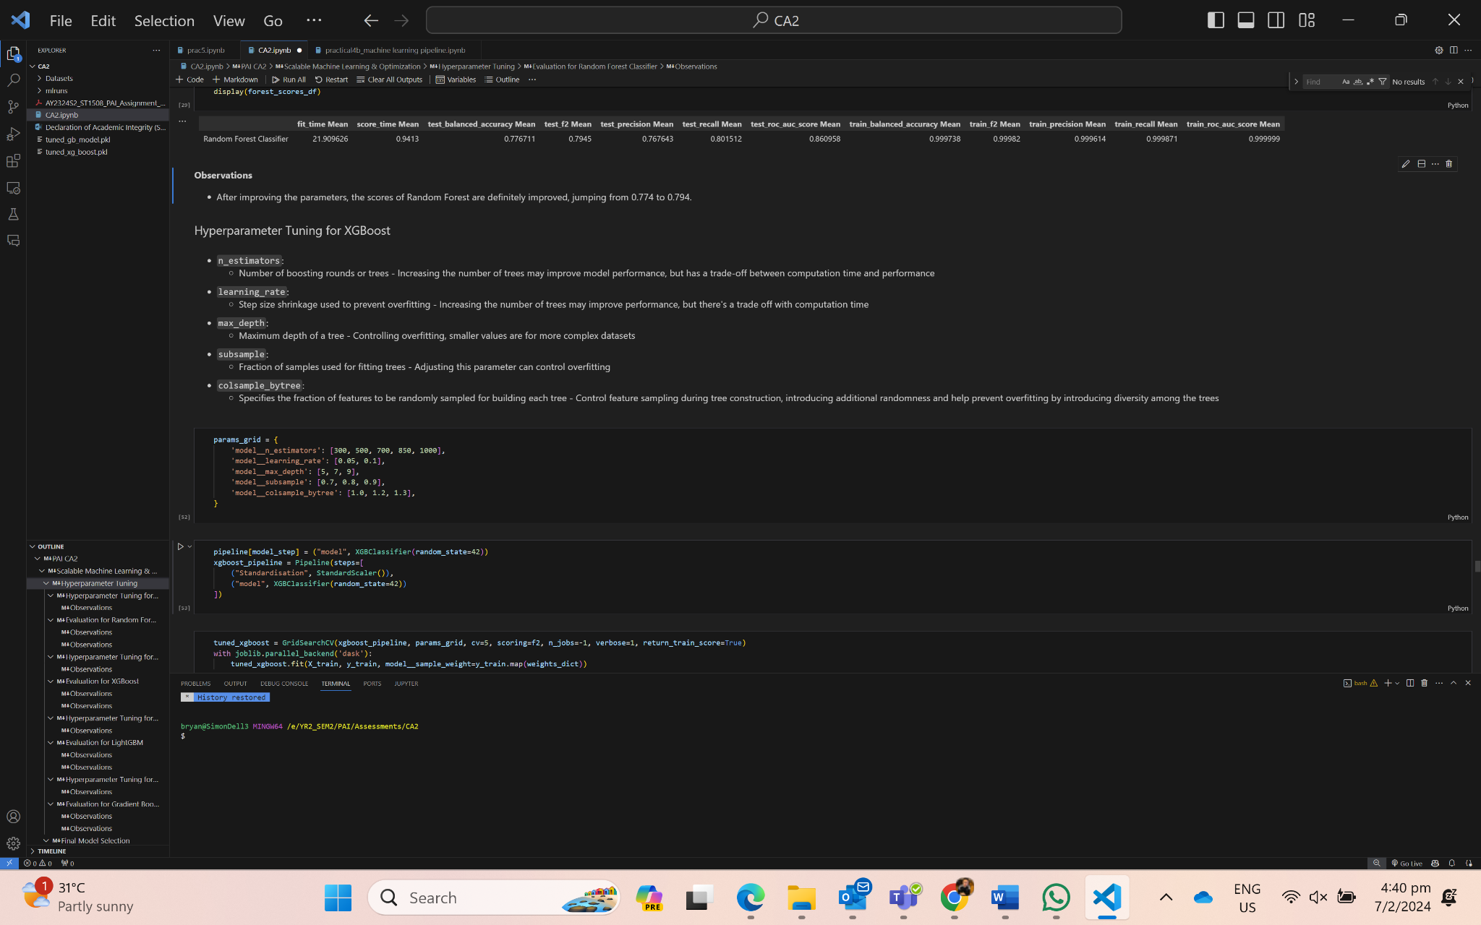
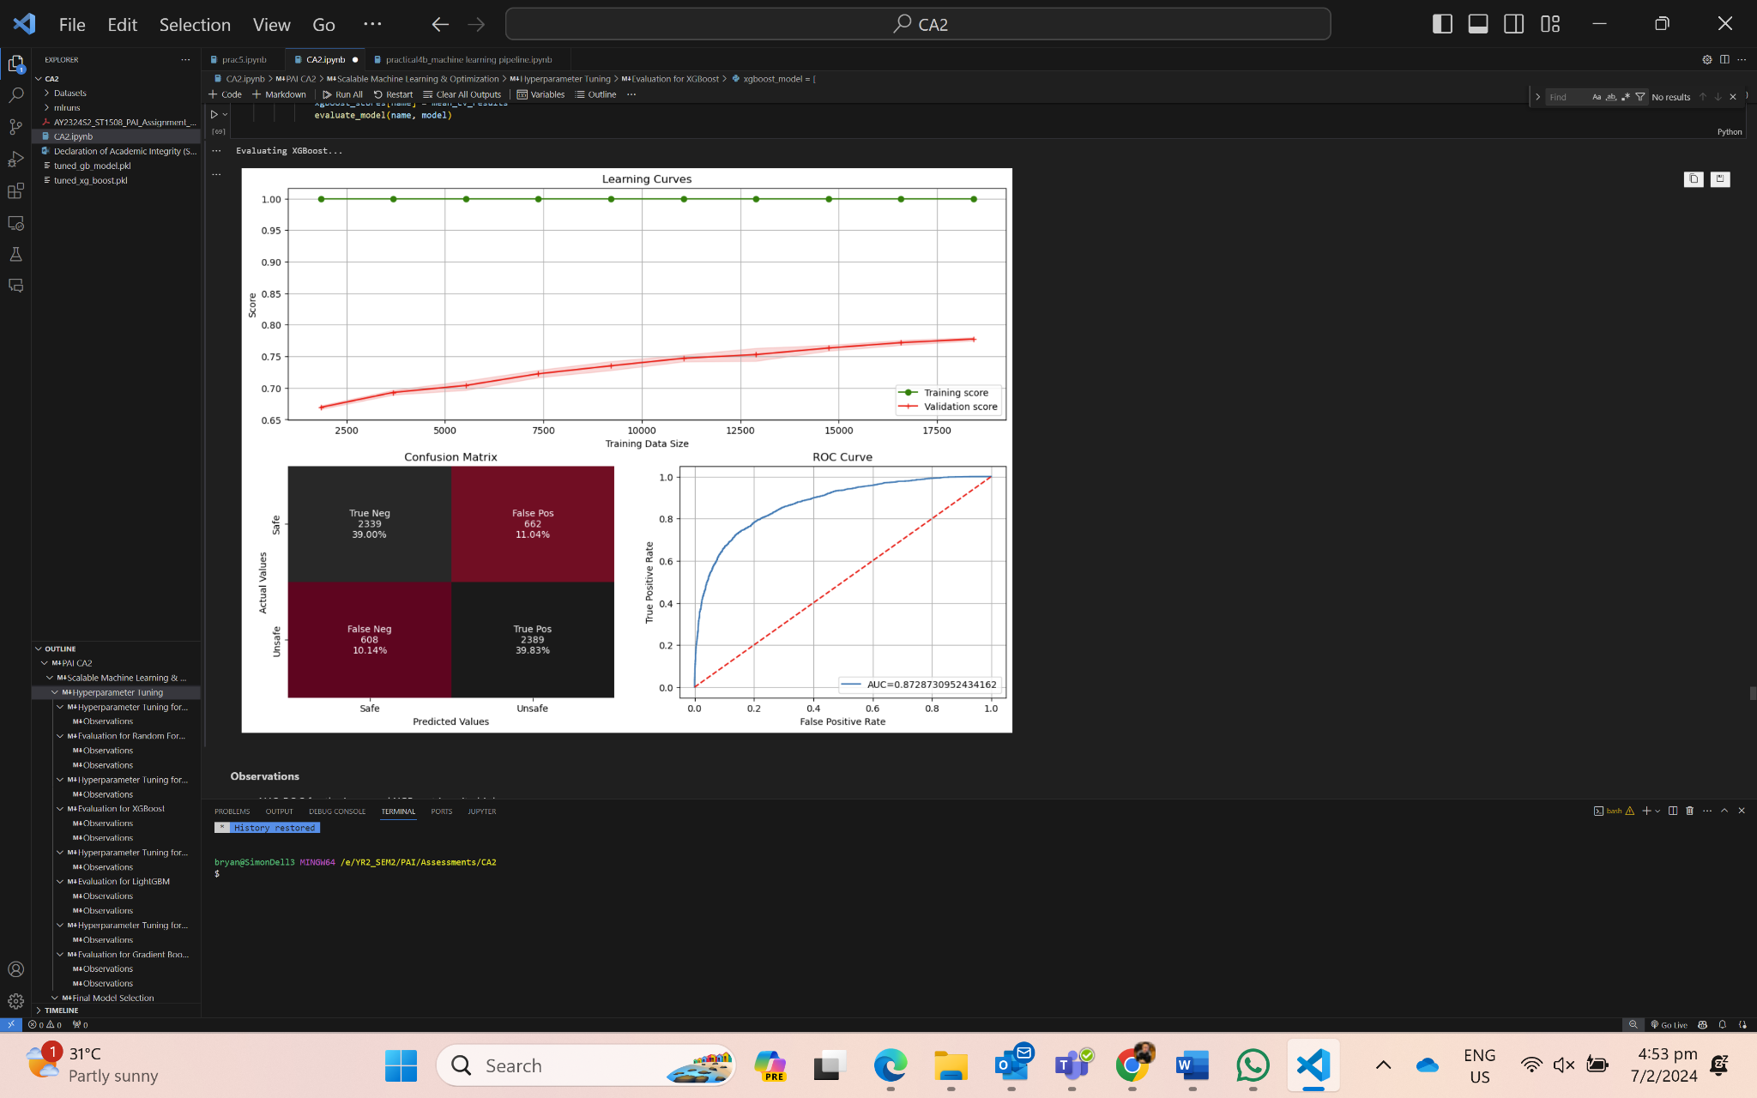
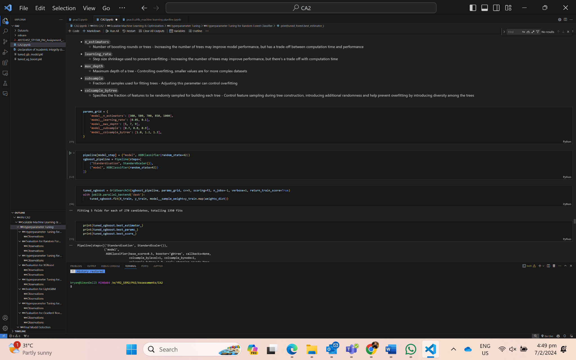
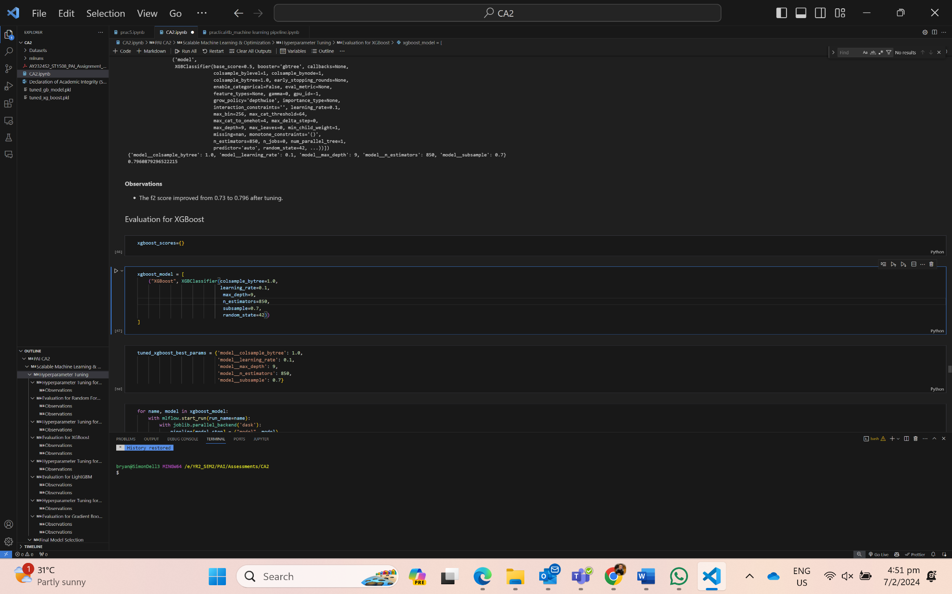
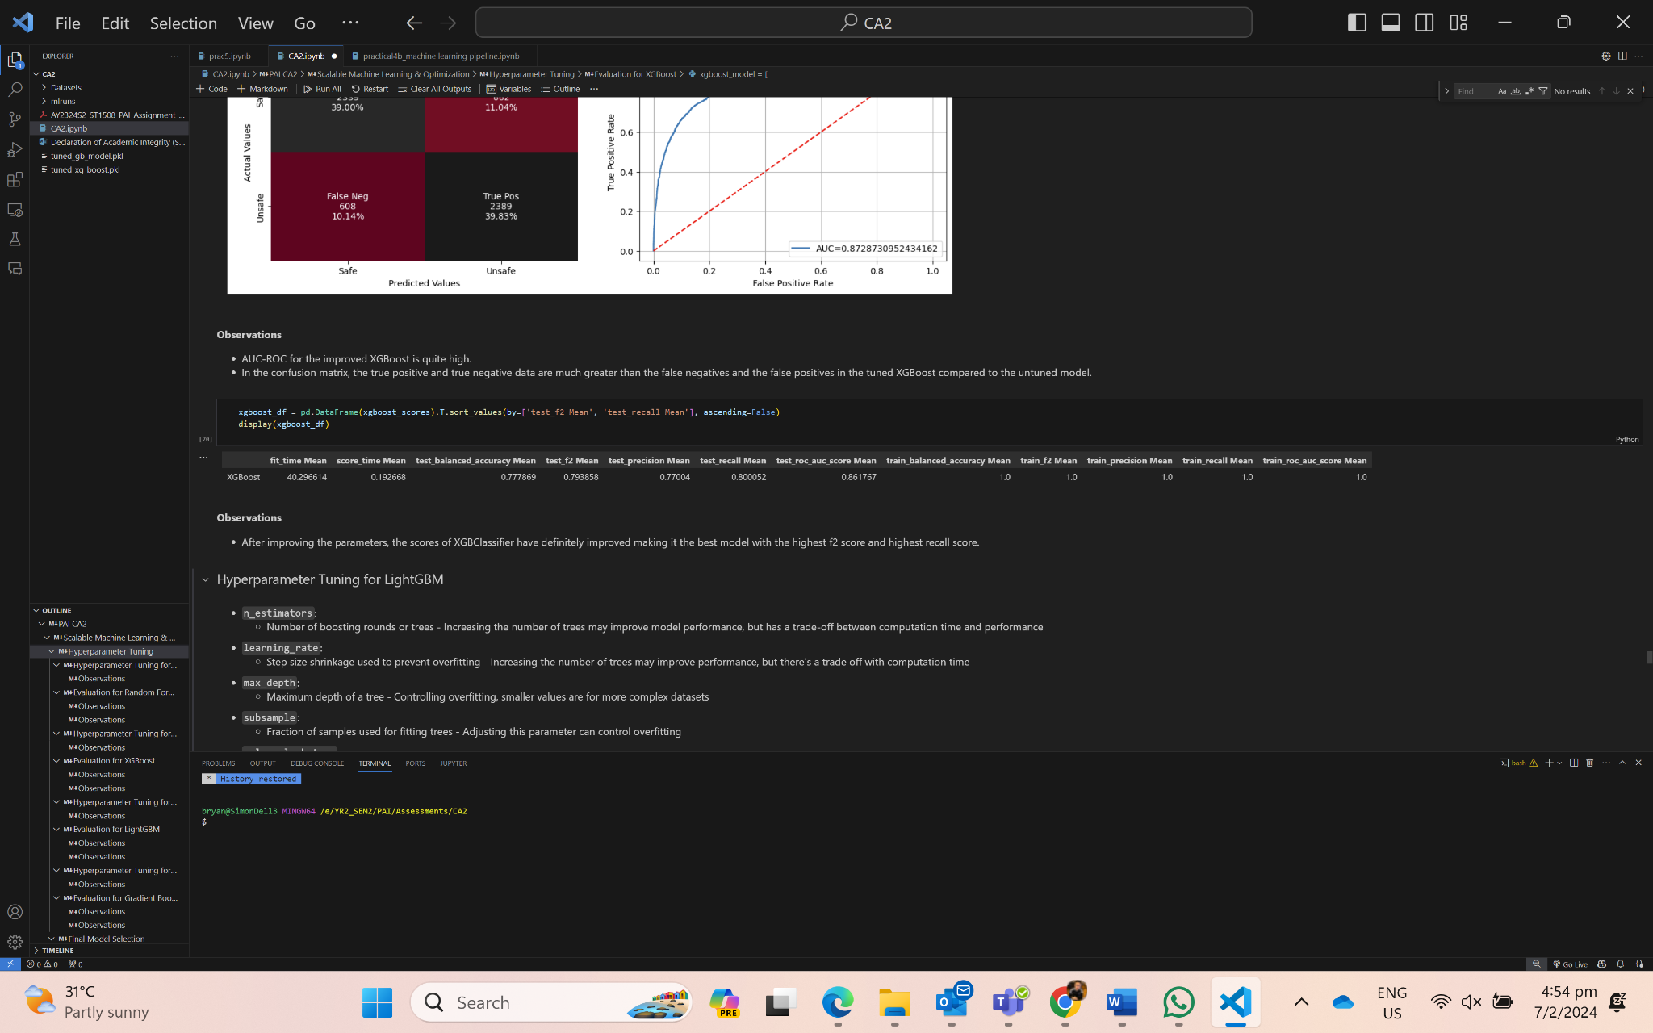
06 {
[Model Optimization (XGBoost)]
Param Grid
Optimal Parameters for best f2 score
}

Slide 22
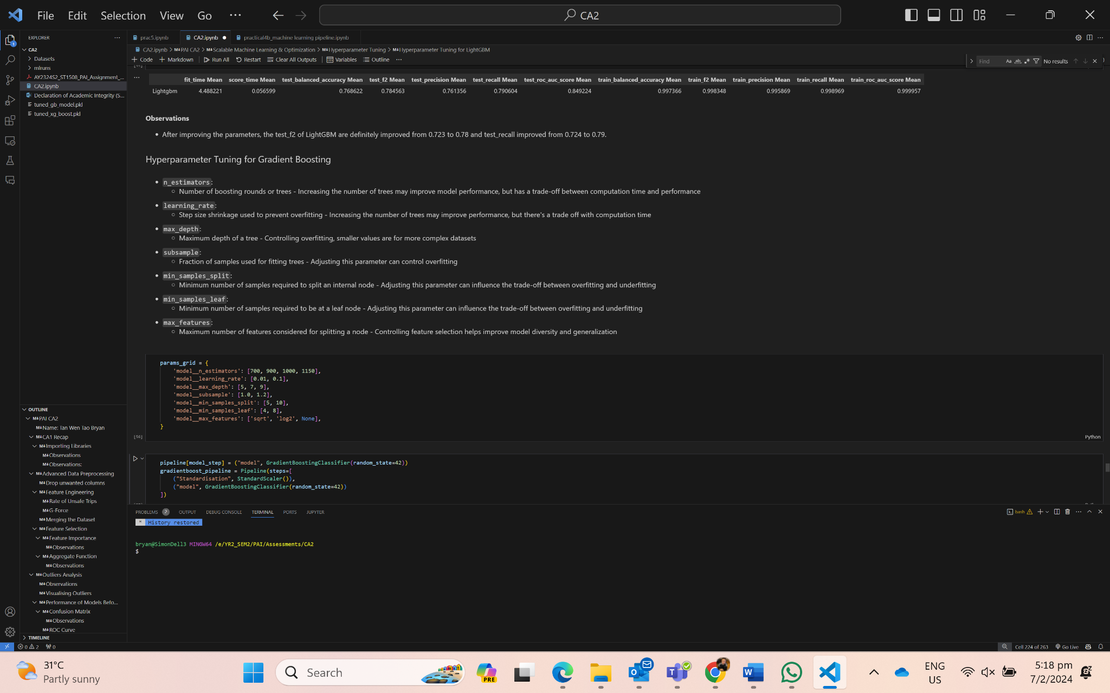
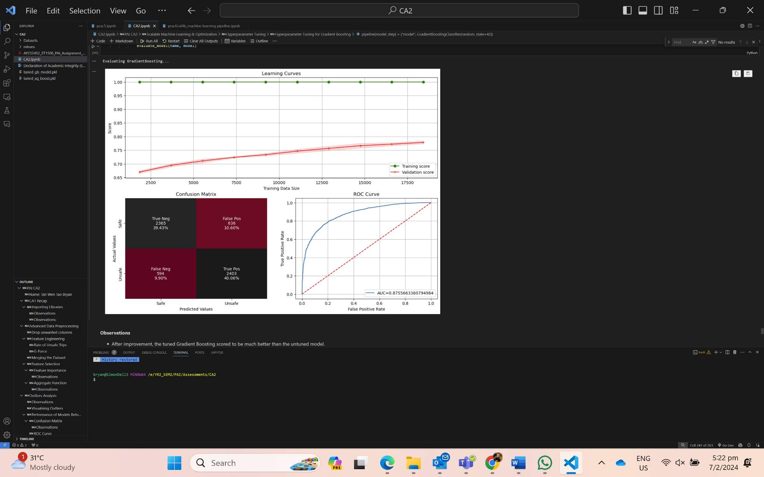
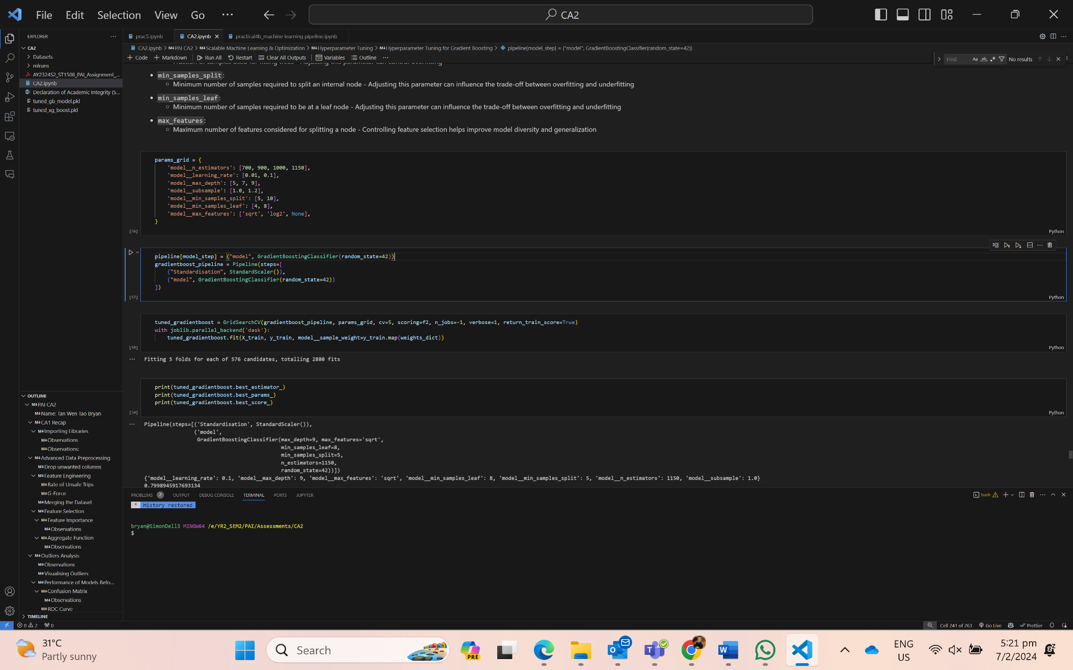
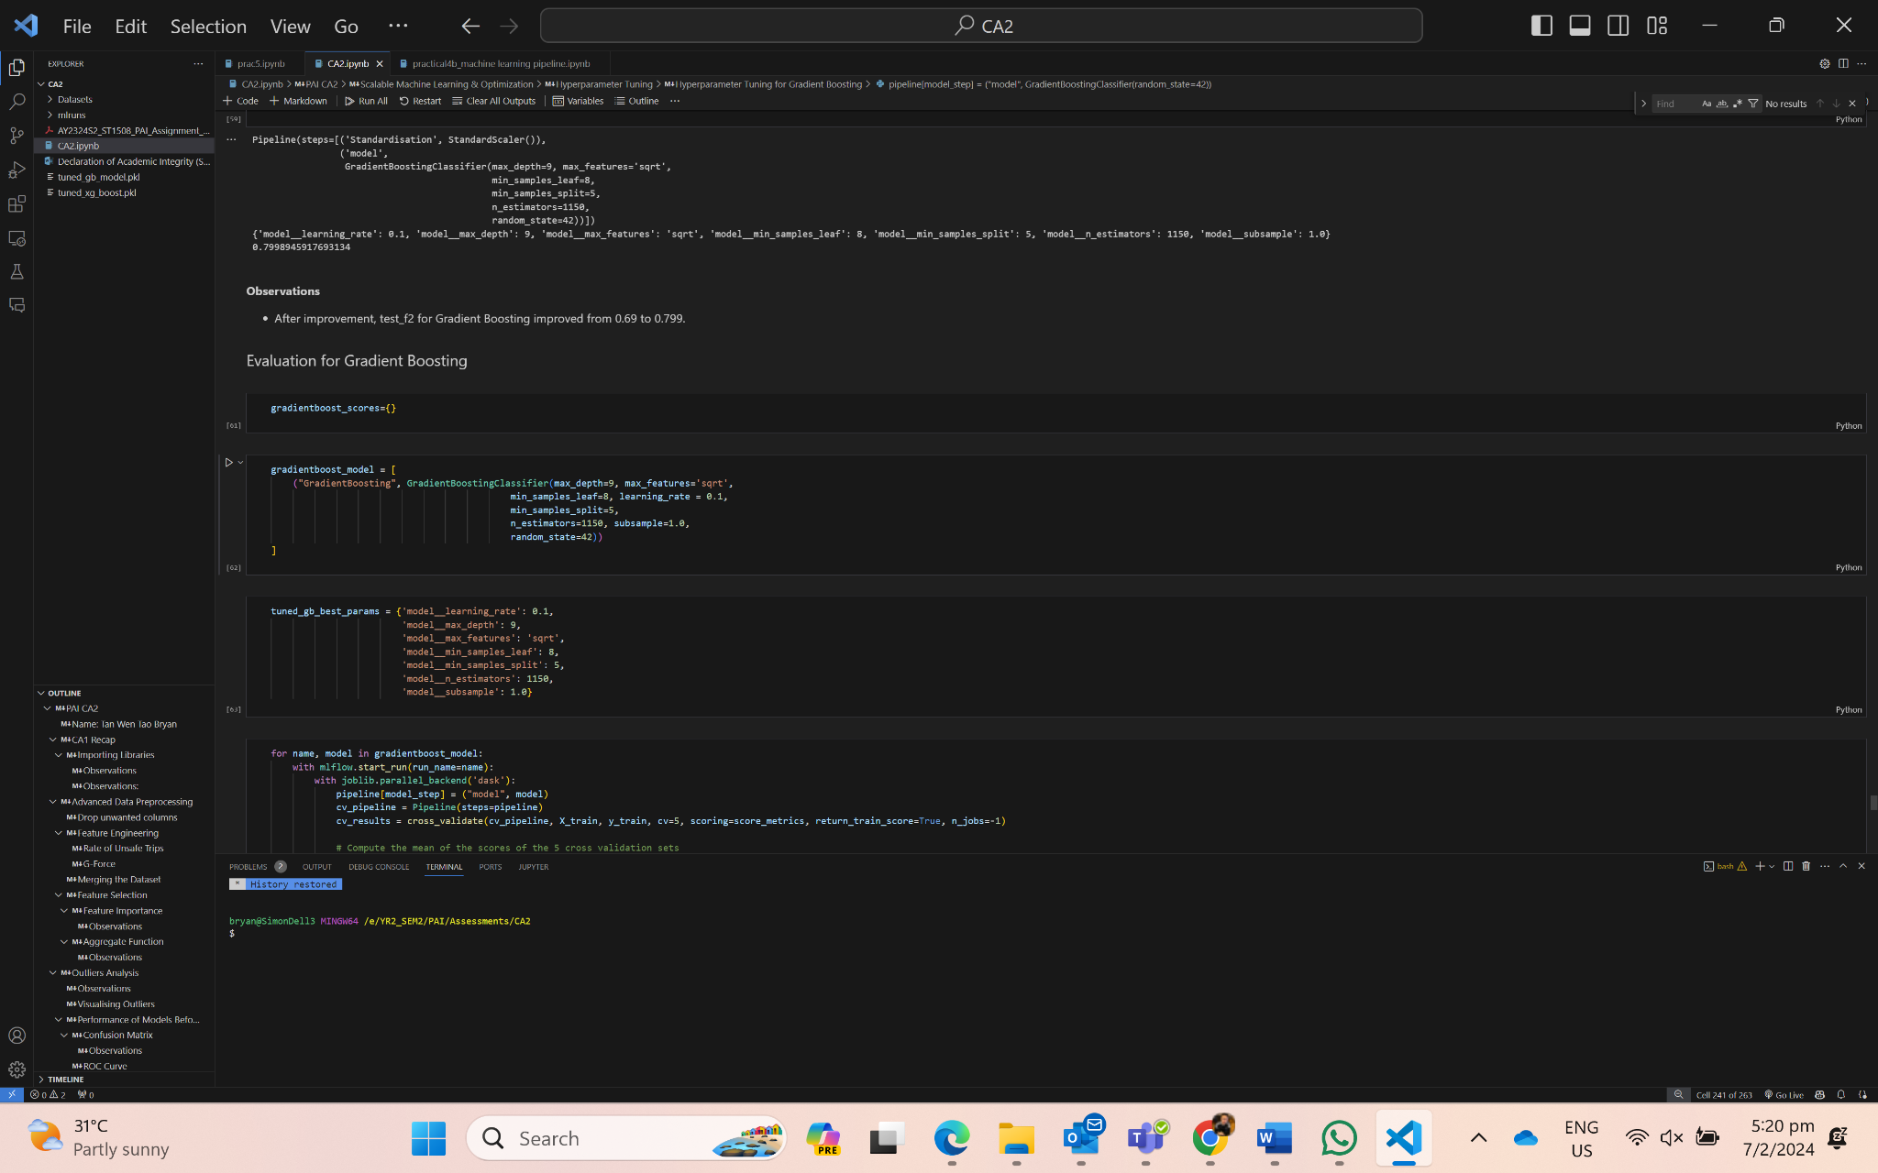
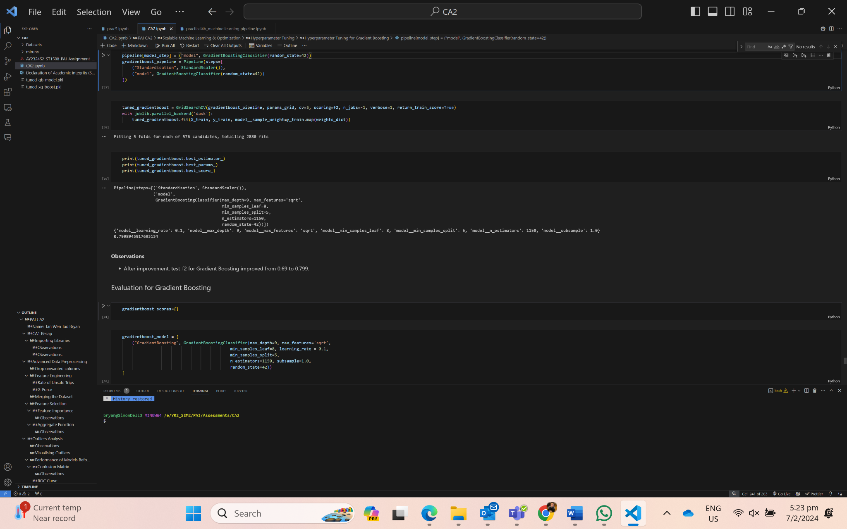
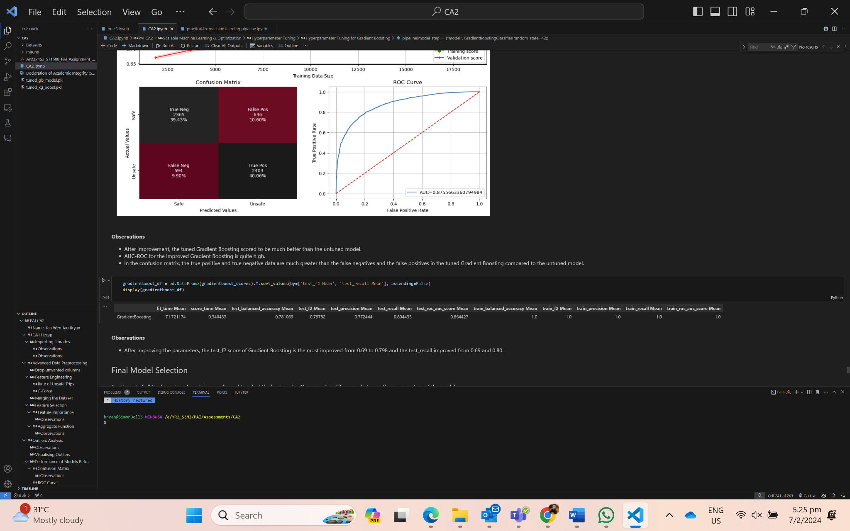
06 {
[Model Optimization (Gradient Boost)]
Param Grid
Optimal Parameters for best f2 score
}

Slide 23



07 {
[Export Final Model]
}

Slide 24

08 {
[Monitoring MLFlow]
Below are the scores of all the models before hyperparameter tuning:
Observations:
Gradient Boosting has the longest fitting time
Random Forest has the best test_f2 and test_recall, but has a long fitting time due to it being a more complex model
LightGBM and XGBoost are also models, besides Gradient Boosting, with the highest f2 score and recall score, with the shortest score time compared to other models
}

Slide 25



08 {
[Monitoring MLFlow]
Below shows the scores between untuned and tuned models:
Observations:
Mean_fit_time - RandomForestClassifier: 21.9, XGBoost: 33.6, LightGBM: 4.49, GradientBoosting: 65.0. LightGBM is the most lightweight model with the fastest training time, followed by XGBoost, RandomForest and GradientBoosting is the most heavyweight model with the longest training time.
Mean_score_time - RandomForestClassifier: 0.941, XGBoost: 0.161, LightGBM: 0.057, GradientBoosting: 0.271. LightGBM is the most lightweight model with the fastest scoring time, followed by XGBoost, GradientBoosting and Random Forest is the most heavyweight model with the longest scoring time.
Mean_test_f2 - RandomForestClassifier: 0.794, XGBoost: 0.791, LightGBM: 0.785, GradientBoosting: 0.796. GradientBoosting is the most robust model to predict if a trip was safe or unsafe, followed by RandomForestClassifier, XGBoost and LightGBM.
Mean test_recall - RandomForestClassifier: 0.801, XGBoost: 0.798, LightGBM: 0.791, GradientBoosting: 0.803. GradientBoosting is the best model to correctly identify most of the dangerous trips, minimizing the risk of overlooking safety concerns.
}

Slide 26


09 {
[Tkinter Application]
GoCab Application GUI
Supports
Light & Dark Mode
Multi model
Single Prediction
Batch Prediction
}

Slide 27


09 {
[Tkinter Application]
Inserting Real-Time Data
}

Slide 28


09 {
[Tkinter Application]
Batch Processing (Insert Multiple rows of data)
Prediction can be saved as csv or xlsx
}

Slide 29
10{
[Conclusion]
GoBest Cab Data Science Team has successfully navigated through the second phase of the project.
Managed to perform advanced data preprocessing like handling outliers in high dimensional data, build, optimize and scale machine learning models, use MLFlow to track and monitor the model experiments and performance, and lastly, deploy the model in the form of a GUI using Tkinter.
As such, the team has successfully developed an easy to use, and intuitive machine learning software application that can help the administrators and managers to identify safe and dangerous trips
Allow them to come up with precautions to minimize the occurrences of dangerous trips, greatly reducing the probability of accidents to happen and possibly saving many cab drivers lives
}

Slide 30
References
https://www.run.ai/guides/machine-learning-operations/mlflow
https://tkdocs.com/
https://www.nsf.gov/news/classroom/images/Gravity.pdf

Slide 31
Contributions by Team Members
Name | Contributions | Tasks
Tan Wen Tao Bryan | 25% | Advanced Data Preprocessing + Model Monitoring/Dev
Ryan Yeo | 25% | Model Deployment (GUI) + Model Dev
Zachary Leong Yao Jie | 25% | Model Deployment (GUI) + Advanced Data Preprocessing
Ethan Jedidiah Pang Kin Fong | 25% | Model Dev + Model Optimization

